Slide 1
Descriptive analyses of statutory notifications from residential care facilities for older persons and people with disabilities in Ireland.
Stephanie O’Regan, PhD, Research Assistant, HIQA.
February 2021.

Slide 2
Background:
A review of statutory notifications found that different jurisdictions report different adverse events at different times.
Northern Ireland and Ireland: ↑ no. of notifications reported.
New Zealand and Australia: ↓ no. of notifications reported.
Death of a resident was the only adverse event reported across all jurisdictions.
Events involving serious injury, unexplained absence and abuse were commonly reported.
Knowledge of receipt of notifications and how they have changed over time is limited at national level.

Slide 3
Background:
In Ireland, there are two categories of statutory notifications based on their reporting requirement: 3-day and Quarterly.
3-day notifications are received individually by HIQA within 3-days of a single adverse event occurring.
The different types of 3-day notifications:
Unexpected death
Disease outbreak
Serious injury
Unexplained absence
Allegation of abuse
Allegation of staff misconduct
Staff under review
Unplanned evacuation

Slide 4
Background:
Quarterly notifications are received in composite by HIQA at the end of the annual quarter within the adverse event occurred.
Prior to 2018, Quarterly notifications were reported as a composite notification regardless of the adverse event.
Older persons:
Restraint
Fire alarm activation
Theft or burglary
Any other death
Pressure sores
People with disabilities:
Restraint
Fire alarm activation
Theft or burglary
Any other injury
Any other death

Slide 5
Objective:
Using the Database of Statutory Notifications from Social Care (2013-2019), describe:
The number of statutory notifications in the dataset.
The trends in statutory notifications from residential care facilities for older persons and people with disabilities.
The average risk rating of statutory notifications from residential care facilities for older persons and people with disabilities.

Slide 6
Methods:
The Database of Statutory Notifications from Social Care (2013-2019) was used for analysis.
Analyses were performed using R and designed in tableau.
There were 125,725 notifications in the database.
25,544 notifications without a listed bed number were removed from analyses.
2022 notifications without an assigned risk rating were also removed from analyses.
The following analyses were expressed by service type (older persons and disabilities):
The total number of notifications.
The number of notifications adjusted per 100 registered bed numbers.
The proportion of individual notification types contributing to total notifications.
The trends in the contribution of individual notification types to total notifications.

Slide 7
Methods:
The risk rating of notification types (mean) were calculated and expressed by service type.
NOTE:
The risk rating is expressed as a number that refers to the overall risk of the event/incident to residents.
The risk rating is derived from multiplying the risk of impact of the event/incident on the residents (1 to 5) by the likelihood of the incident reoccuring (1 to 5).
The risk rating can range from 1 to 20.

Slide 8
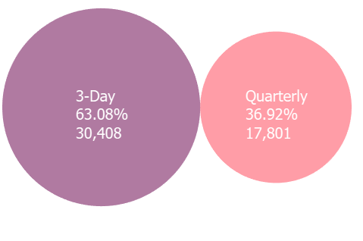
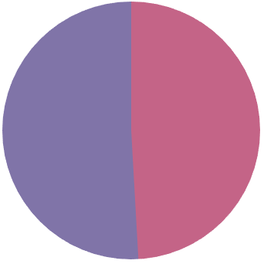
Results:
Total number of notifications received 2013-2019: 98,159
Older persons: 48,209
Disabilities: 49,950
Disabilities:
49,950
51%
Older Persons:
48,209
49%

Slide 9
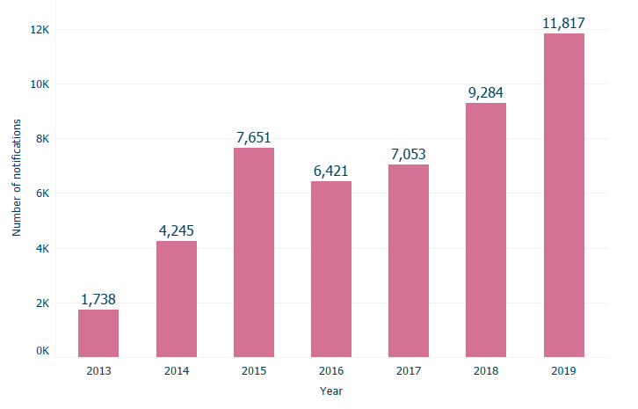
Results:
Partial data for 2013
Pressure ulcers were reported as a serious injury notification from 2013 to 2015 but moved to quarterly notifications from mid-2015 onwards.

Slide 10
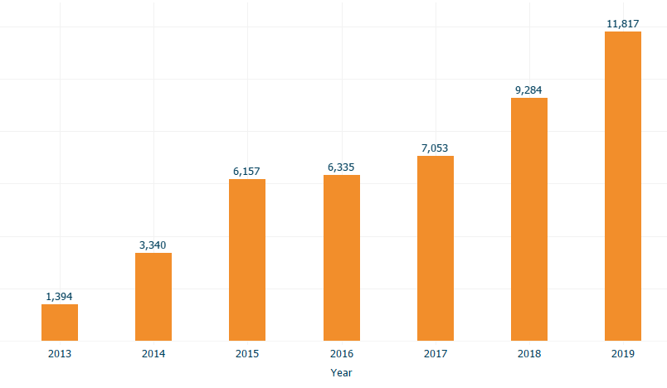
Results:
The volume of notifications received was recalculate excluding all notifications relating to pressure ulcers.

Slide 11
Results:
Year | No. centres | Total notifications (n) | Registered beds (n) | Notifications per 100 beds
2013 | 264 | 1738 | 13461 | 12.9*
2014 | 314 | 4245 | 15997 | 26.5
2015 | 554 | 7651 | 29082 | 26.3**
2016 | 588 | 6421 | 30708 | 20.9
2017 | 596 | 7053 | 31177 | 22.6
2018 | 583 | 9284 | 31074 | 29.9
2019 | 582 | 11817 | 31213 | 37.9

Slide 12
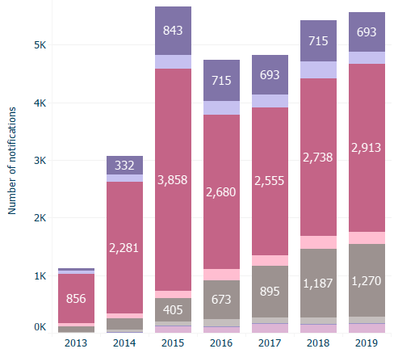
Results:
Unexpected death
Disease outbreak
Serious injury
Unexplained absence
Allegation of abuse
Allegation of staff misconduct
Staff under review
Unplanned evacuation

Slide 13
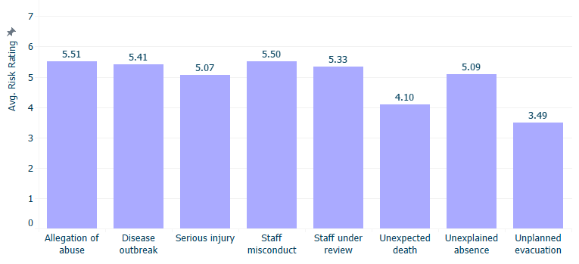
Results:

Slide 14
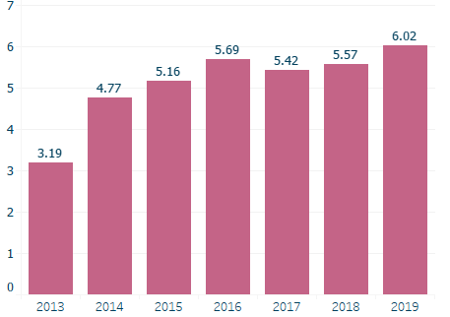
Results:

Slide 15
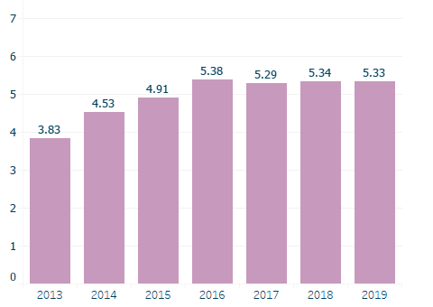
Results:

Slide 16
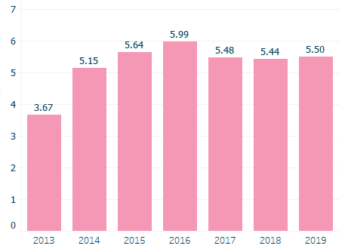
Results:

Slide 17
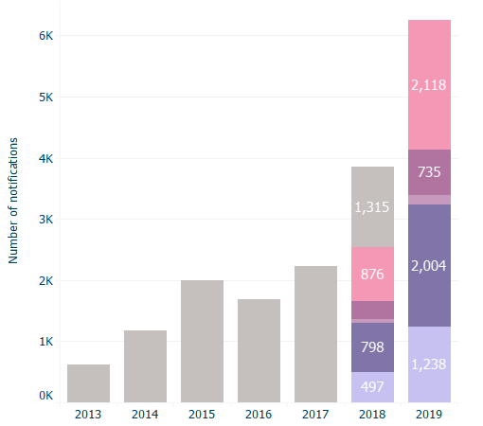
Results:
All composite quarterly notifications
Restraint
Fire alarm activation
Theft
Any other death
Pressure sores

Slide 18
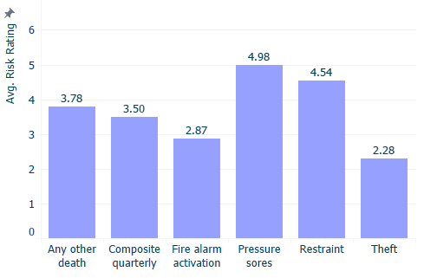
Results:

Slide 19
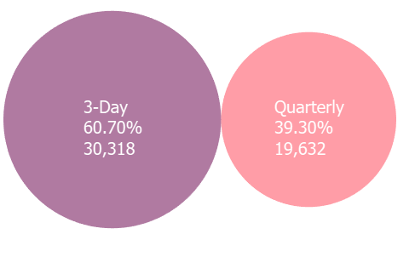
Results:
Total number of notifications received 2013-2019: 98,159
Older persons: 48,209
Disabilities: 49,950
Older Persons:
48,209
49%
Disabilities:
49,950
51%

Slide 20
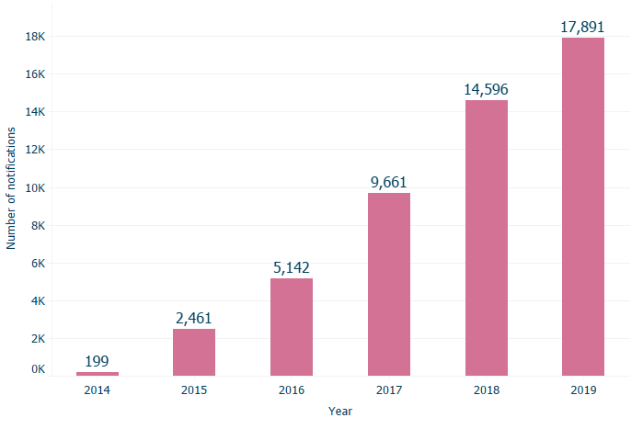
Results:

Slide 21
Results:
Year | No. centres | Total notifications (n) | Registered beds (n) | Notifications per 100 beds
2013 | NA | N/A* | N/A | N/A
2014 | 43 | 199 | 451 | 44.1
2015 | 347 | 2461 | 3108 | 79.2
2016 | 674 | 5142 | 5201 | 98.9
2017 | 912 | 9661 | 6959 | 138.8
2018 | 1171 | 14596 | 9106 | 160.3
2019 | 1237 | 17891 | 9004 | 198.7

Slide 22
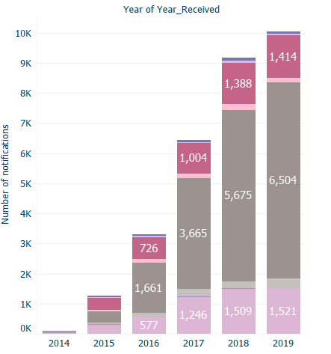
Results:
Unexpected death
Disease outbreak
Serious injury
Unexplained absence
Allegation of abuse
Allegation of staff misconduct
Staff under review
Unplanned evacuation

Slide 23
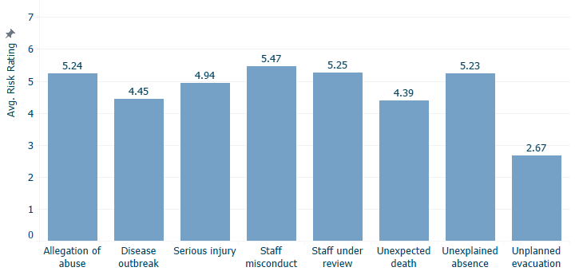
Results:

Slide 24
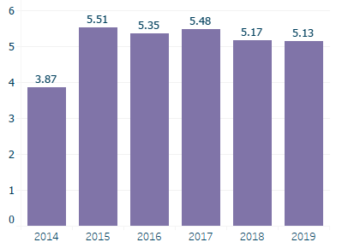
Results:

Slide 25
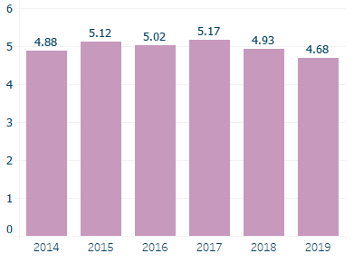
Results:

Slide 26
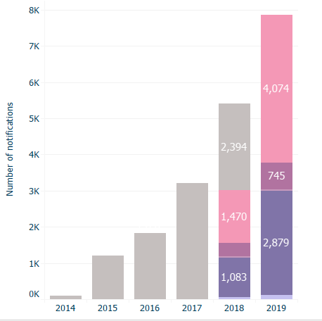
Results:
All composite quarterly notifications
Restraint
Fire alarm activation
Theft or burglary
Any unserious injury
Any other death

Slide 27
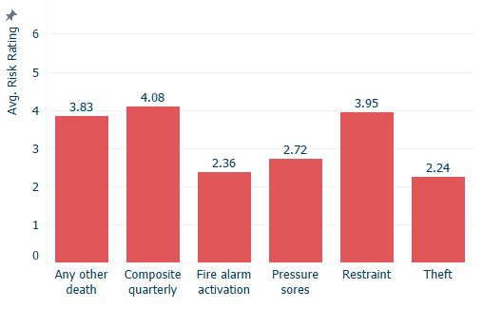
Results:

Slide 28
Main Findings:
The no. notifications received increased from 2013 to 2019, independently of the increase in registered beds and service type.
Increases may be due to more comprehensive reporting or the occurrence of more adverse events.
Notifications of serious injury, unexpected death and allegations of abuse were the most frequent types received.
The mean risk rating across all notification types was low at 2 to 5.5.

Slide 29
Strengths & Limitations:
Strengths:
Number of years statutory notification data is available for
National comprehensive database
Limitations:
Notification data from 2013 is limited.
Challenge of examining over time limited due to external factors.
Registered beds rather than occupied beds.
Received rather than submitted.

Slide 30
With thanks
Niall McGrane, Paul Dunbar, Mary Dunnion, Ian Leistikow, Laura M O’Connor.
Funded by the HRB SDAP award. SDAP-2019-005.
PI: Dr Laura O’Connor
Co-funded and hosted by the Health Information and Quality Authority.
Project Sponsor: Phelim Quinn

