Slide 1

A Human Rights-based approach for Health and Social Care Services
Health Information and Standards Directorate, HIQA
www.hiqa.ie
Email:standards@hiqa.ie

Slide 2

Introduction
What is the purpose of this slide deck?
This slide deck has been developed by the Health Information and Quality Authority (HIQA) to provide a teaching resource on a human rights-based approach to care and support in health and social care services.
Who is this slide deck for?
This slide deck will be useful for those teaching health and social care students and those providing training and continuous professional development (CPD) for health and social care staff.
Notes:
What is the purpose of this Slide Deck?
This slide deck has been developed by the Health Information and Quality Authority (HIQA) to provide a teaching resource on a human rights-based approach to care and support in health and social care services. This slide deck is based on the development of HIQA’s Guidance on a Human Rights-based Approach in Health and Social Care Services, published in 2019, and on the evidence review which informed that guidance. The guidance was developed in conjunction with Safeguarding Ireland, and was part-funded by a grant from the Irish Human Rights and Equality Commission.
Who is this Slide Deck for?
The slide deck will be useful for those teaching health and social care students and those providing training and CPD for health and social care staff.
Managers of health and social care services, policy makers, and others who have a personal or professional interest in human rights and or health and social care may also find this slide deck useful.

Slide 3
Introduction
How can this slide deck be used?
The slide deck has been designed to be used in a flexible way. Content has been divided into different sections and these can be delivered together, separately as individual modules, or incorporated into your existing modules/lectures.
These slides may be adapted for teaching and training purposes.
We ask that you acknowledge HIQA as the source of these materials. For the most recent version of this slide deck, visit our Learning Hub.
Notes:
How can this Slide Deck be used?
The slide deck has been designed to be used in a flexible way.
Content has been divided into different sections and these can be delivered together or separately as individual modules.
These slides may be adapted for teaching and training purposes.
However, we ask that you acknowledge HIQA as the source of these materials.

Slide 4
Introduction
About the Guidance
The Guidance on a Human Rights-based Approach in Health and Social Care Services was developed in conjunction with Safeguarding Ireland, and was part-funded by a grant from the Irish Human Rights and Equality Commission (IHREC).
Safeguarding Ireland is a national body tasked with promoting safeguarding of vulnerable adults to protect them from abuse.
IHREC is Ireland’s national human rights and equality institution. Its purpose is to protect and promote human rights and equality in Ireland.
Notes:
The Guidance on a Human Rights-based Approach in Health and Social Care Services was developed by HIQA in conjunction with Safeguarding Ireland, and was part-funded by a grant from the Irish Human Rights and Equality Commission.
Safeguarding Ireland promotes safeguarding of vulnerable adults to protect them from all forms of abuse by persons, organisations and institutions and to develop a national plan for promoting their welfare.
IHREC is Ireland’s national human rights and equality institution. Its purpose is to protect and promote human rights and equality in Ireland and build a culture of respect for human rights, equality and intercultural understanding in the State.

Slide 5

Introduction
The Guidance is available to download here from the HIQA website (www.hiqa.ie).
You can also visit the HIQA Learning Hub which was developed to provide links to online learning courses, guides and videos for frontline staff, students and academics, as well as people using health
and social care services.
Notes:
The Guidance on a Human Rights-based Approach in Health and Social Care Services is available to download from the HIQA website and Learning Hub (www.hiqa.ie/learning-hub).
The guidance outlines a way of working for health and social care staff to assist them to uphold human rights in their day-to-day work.

Slide 6
Contents of the slide deck
Section 1: About the Health Information and Quality Authority (Slides 7 – 12)
Section 2: Introduction to human rights (Slides 13 – 18)
Section 3: Human rights in an international context (Slides 19 – 24)
Section 4: Human rights in an Irish context (Slides 25 – 39)
Section 5: Human rights in health and social care settings (Slides 40 – 58)
Section 6: A human rights-based approach (FREDA Principles) (Slides 59 – 122)
Section 7: Case studies, practical exercise and useful resources (Slides 123 – 137)

Slide 7
Section 1:
About the Health Information and Quality Authority (HIQA)
Notes:
This section provides a brief outline of the role of the Health Information and Quality Authority (HIQA) and the function of HIQA’s Health and social care Standards Team.

Slide 8
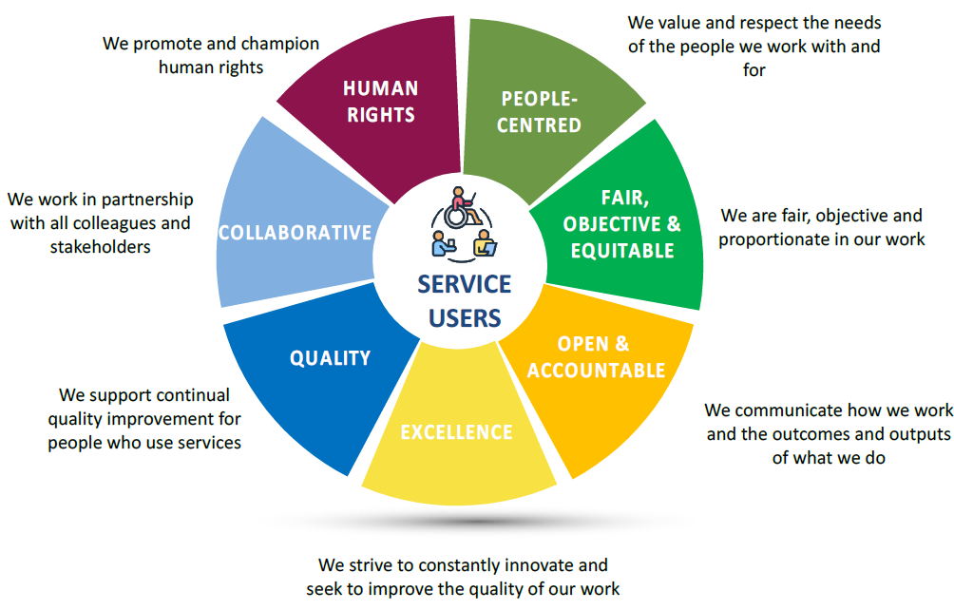
The Health Information and Quality Authority
HIQA is an independent statutory authority, established in 2007, to improve the safety and quality of health and social care services for the public.

Slide 9




HIQA’s functions:
Setting standards for health and social care services
Developing person-centred standards and guidance, based on evidence and international best practice, for health and social care services in Ireland
Regulating social care services
The Chief Inspector of Social Services within HIQA is responsible for registering and inspecting residential services for older people and people with a disability, and children’s special care units
Monitoring services
Monitoring the safety and quality of permanent international protection accommodation service centres, health services and children’s social services against the national standards. Where necessary, HIQA investigates serious concerns about the health and welfare of people who use health services and children’s social services.
Regulating health services
Regulating medical exposure to ionizing radiation

Slide 10


HIQA’s functions (continued):
Health Technology Assessment
Evaluating the clinical and cost-effectiveness of health programmes, policies, medicines, medical equipment, diagnostic and surgical techniques, and health promotion and protection activities, and providing advice to enable the best use of resources and the best outcomes for people who use our health service.
Health Information
Advising on the efficient and secure collection and sharing of health information, setting standards, evaluating information resources and publishing information on the delivery and performance of Ireland’s health and social care services.
National Care Experience Programme
Carrying out national service-user experience surveys across a range of health and social care services, with the Department of Health
and the HSE.

Slide 11
Standards and guidance development
Under the Health Act 2007, HIQA:
Sets standards for the safety and quality of health and social care services
Promotes safety and quality in the provision of health and social services for the benefit of the health and welfare of the public
HIQA’s statutory remit under the Health Act 2007 was extended by amendments under the Patient Safety (Notifiable Incidents and Open Disclosure) Act 2023 (the Patient Safety Act) to include private hospitals and future prescribed private health services.
Notes:
Section 7 of the Health Act 2007 outlines HIQA’s role in promoting safety and quality in the provision of health and social services for the benefit of the health and welfare of the public.
Among its many functions, HIQA has a statutory responsibility for developing national standards for health and social care services in Ireland. The national standards developed by HIQA aim to help drive improvements in the quality and safety of health and social care services.
National standards help the people who provide services and people who use services to understand what a high-quality, safe service looks like.

Slide 12
Purpose of national standards and guidance
National standards
provide a common language to describe what high-quality, safe, person-centred care looks like.
create a basis for services to improve the quality and safety of the care they deliver, by identifying strengths and highlighting areas for improvement.
assist people using services to understand what they should expect from a service.
promote practice that is up to date, effective and consistent.
Guidance
help staff to implement national standards, or as a guide to making improvements in a particular area.
Notes:
Setting high quality standards is an important driver to improve the quality and safety of health and social care. National standards promote best practice that is evidence-based, timely, effective and consistent.
Standards help service providers to identify their strengths within the service they are providing and also to identify areas that may need improvement.
HIQA supports implementation of the national standards by developing guidance and other resources to support staff to understand how the standards relate to their own everyday work and to help services to make improvements in particular areas.

Slide 13
Section 2:
Introduction to human rights
Notes:
This section provides a brief background on human rights and outlines different categories of human rights. An overview of two key international human rights instruments (Universal Declaration of Human Rights 1948 and the European Convention on Human Rights 1950) is also provided in this section.

Slide 14
Human rights
What are human rights?
Human rights are the basic rights and freedoms that all people should enjoy, regardless of nationality, place of residence, gender, national or ethnic origin, colour, religion, language or any other status or characteristic.
Who has human rights?
We are all born with human rights regardless of who we are, where we are from or any other status or characteristics.
Notes:
Human rights are the basic rights and freedoms that all people should enjoy, including people using services and staff who provide services. Human rights are about people being treated with fairness, respect, equality and dignity, having a say over their lives and participating as fully as possible in decisions about their care and support. There is a duty on the State and on health and social care providers to uphold the human rights of people using services and staff who provide services.
Everyone is born with human rights regardless of who they are, where they are from or any other status or characteristic. Although individuals’ ability to exercise their rights can sometimes be limited or restricted when the law allows, rights cannot be taken away from people. It is important to recognise that some people using services, because of their needs or circumstances, require additional help and support in realising their human rights and achieving the best possible outcomes.
Human rights are found in international (mainly United Nations), regional (European) treaties, and in national constitutions and national legislation.

Slide 15
Categories of human rights
Absolute rights cannot be restricted in any circumstance, including a national emergency (for example, the right to freedom from torture).
Qualified rights can be restricted in certain circumstances if the interference is justified. The restriction must be in the interest of the wider community or to protect other people’s rights (for example, protection of health and prevention of crime).
Limited rights can only be restricted in specific situations set out in law (for example, being arrested for committing a crime).
Notes:
Human rights can fall into different categories. These are:
Absolute rights
These are rights that cannot be restricted in any circumstance, including a national emergency. They also cannot be balanced against the interest of the general public or the rights of others. An example of an absolute right is the right to freedom from torture.
Qualified rights
These are rights that can be restricted in certain circumstances, provided that in each case there are good reasons to justify this interference. Qualified rights may need to be balanced against the rights of the wider community to achieve a fair outcome. For example, qualified rights may be restricted for the protection of other people’s rights, national security, public safety and the protection of health. Travel restrictions imposed during the COVID-19 pandemic are an example of a qualified right (in this case the right to liberty) being restricted for the protection of the health of the wider community.
Limited rights
These are rights that can only be restricted in specific situations that are set out in law (for example, being arrested for committing a crime).

Slide 16
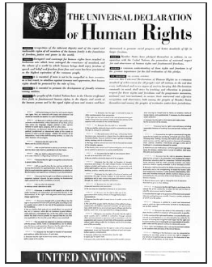
History of human rights
Universal Declaration of Human Rights (UDHR) 1948
Milestone document in the history of human rights
Established fundamental human rights to be universally protected
Expression of values and agreed-upon standards but Declaration is not legally binding
UDHR was a precursor to the European Convention on Human Rights (ECHR).
Notes:
The 1948 Universal Declaration of Human Rights (UDHR) is considered to be a milestone document in the history of human rights. It set out, for the first time, fundamental human rights that should be universally protected. The UDHR is considered to be the foundation of international human rights law. While the Declaration is not legally binding, it contains a series of principles and rights that are based on human rights standards that became enshrined in other legally binding international treaties. The Declaration is an expression of fundamental values and agreed-upon standards and represents a strong commitment by each State to its implementation. The Declaration is a precursor to the European Convention on Human Rights (ECHR) which is directly derived from the UDHR. While the UDHR has had a profound influence on the development of international human rights law, conventions are stronger than Declarations because they are legally binding for governments that have signed them.

Slide 17
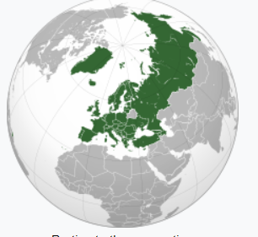
History of human rights continued
European Convention on Human Rights (ECHR)
ECHR is the basis of the European human rights system, drafted by the Council of Europe in 1950, post Second World War
First regional treaty designed to protect human rights, democracy and the rule of law
ECHR’s main purpose is to limit a state’s interference with the rights of citizens
Enforced by the European Court of Human Rights.
Notes:
The ECHR is directly derived from the UDHR and it forms the basis of the European human rights system. The ECHR was drafted by the Council of Europe* in 1950, after the Second World War, and has been in force since 1953. The ECHR was the first regional treaty designed to protect human rights, democracy and the rule of law. The rights set out in the ECHR are enforced by the European Court of Human Rights, which is located in Strasbourg. The main purpose of the ECHR was to limit a state’s interference with the rights of citizens. All 47 Council of Europe member states have signed the ECHR.
*The Council of Europe focuses on human rights and the rule of law across its 47 Member States, which account for almost the entire continent of Europe. Ireland joined the Council of Europe in 1949. The primary human rights text of the Council of Europe is the ECHR. The rights set out in the ECHR are enforced by the European Court of Human Rights, which is located in Strasbourg.

Slide 18
Human rights defined under ECHR:
Article 1: Obligation to respect Human Rights | Article 8: Right to respect for private and family life
Article 2: Right to life | Article 9: Freedom of thought, conscience and religion
Article 3: Prohibition of torture | Article 10: Freedom of expression
Article 4: Prohibition of slavery and forced labour | Article 11: Freedom of assembly and association
Article 5: Right to liberty and security | Article 12: Right to marry
Article 6: Right to a fair trial | Article 13: Right to an effective remedy
Article 7: No punishment without law | Article 14: Prohibition of discrimination
Notes:
States which have signed up to the ECHR are bound by international law to secure for everyone within their jurisdiction the rights and freedoms set out in it. The human rights defined under the ECHR are:
Article 1: Obligation to respect human rights
Article 2: Right to life
Article 3: Prohibition of torture
Article 4: Prohibition of slavery and forced labour
Article 5: Right to liberty and security
Article 6: Right to a fair trial
Article 7: No punishment without law
Article 8: Right to respect for private and family life
Article 9: Freedom of thought, conscience and religion
Article 10: Freedom of expression
Article 11: Freedom of assembly and association
Article 12: Right to marry
Article 13: Right to an effective remedy
Article 14: Prohibition of discrimination
Article 8 has been identified as the most influential of the articles which directly affect the provision of healthcare. It has been interpreted as providing for a right to self-determination. This fundamentally shapes the nature of healthcare decision-making.

Slide 19
Section 3:
Human rights in an
international context
Notes:
This section provides an overview of human rights within an international context.
Details of the core international human rights instruments are included and the three main procedures for bringing complaints of breaches of human rights are also set out in this section.

Slide 20
Core international human rights instruments
Human rights instrument | Monitoring body | Date established
1. Convention on the Elimination of All Forms of Racial Discrimination | CERD | 21 December 1965
2. International Covenant on Civil and Political Rights | CCPR | 16 December 1966
3. International Covenant on Economic, Social, and Cultural Rights | CESCR | 16 December 1966
4. Convention on the Elimination of All Forms of Discrimination Against Women | CEDAW | 18 December 1979
5. Convention against Torture and Other Cruel, Inhuman or Degrading Treatment or Punishment | CAT | 10 December 1984
Notes:
There are nine core international human rights instruments. These core instruments along with their monitoring bodies are listed over the following two slides.
Each of the core instruments has established a committee of experts to monitor implementation of the treaty provisions by its States parties. These core instruments are Conventions, which are legally binding international treaties that may be ratified by a number of states.
Please note monitoring body abbreviations:
CERD = Committee on the Elimination of Racial Discrimination
CCPR = Committee on Civil and Political Rights
CESCR = Committee on Economic, Social and Cultural Rights
CEDAW = Committee on the Elimination of Discrimination Against Women
CAT = Committee Against Torture

Slide 21
Core international human rights instruments
Human rights instrument | Monitoring body | Date established
6. Convention on the Rights of the Child | CRC | 20 November 1989
7. International Convention on the Protection of the Rights of All Migrant Workers and Members of Their Families | CMW | 18 December 1990
8. International Convention for the Protection of All Persons from Enforced Disappearance | CPED | 20 December 2006
9. Convention on the Rights of Persons with Disabilities | CRPD | 13 December 2006
Further information available at:
https://www.ohchr.org/EN/ProfessionalInterest/Pages/CoreInstruments.aspx
Notes:
Please note monitoring body abbreviations:
CRC = Committee on the Rights of the Child
CMW = Committee on Migrant Workers
CPED = Committee on Enforced Disappearances
CRPD = Committee on the Rights of Persons with Disabilities

Slide 22
Charter of Fundamental Rights of the European Union 2000
The Charter of Fundamental Rights of the European Union includes all personal, civic, political, economic, and social rights enjoyed by people within the EU in one document. It covers:
The rights found in the case law of the Court of Justice of the EU
The rights and freedoms enshrined in the ECHR
Other rights and principles deriving from the constitutions of EU countries.
Within the charter, rights and freedoms are included under six titles:
1. Dignity | 2. Freedoms
3. Equality | 4. Solidarity
5. Citizen’s rights | 6. Justice
Further information available at:
http://www.europarl.europa.eu/charter/pdf/text_en.pdf
Notes:
All of the rights of every individual living within the European Union have been collated into one single document, the Charter of Fundamental Rights of the European Union. The charter has been updated in light of changes in society, social progress and scientific and technological developments and became legally binding in December 2009. The charter brings together all of the personal, civic, political, economic and social rights enjoyed by people within the EU in one single document.
The charter covers:
All the rights found in the case law of the Court of Justice of the EU
The rights and freedoms enshrined in the ECHR
Other rights and principles resulting from the common constitutional traditions of EU countries and other international instruments, including the 9 core international conventions.
In the charter, rights and freedoms are included under 6 titles; dignity, freedoms, equality, solidarity, citizen’s rights and justice. In order to reflect modern society, the charter has also included ‘third generation’ fundamental rights, such as data protection, guarantees on bioethics and transparent administration.
At a national level, the charter applies to EU Member States only when they are implementing EU law. If a situation does not relate to EU law, it is up to national authorities, including the courts, to enforce fundamental rights. Where the Charter does not apply, fundamental rights continue to be guaranteed at a national level according to the constitutional systems of the Member States.

Slide 23

European Charter of Patients’ Rights 2002
The European Charter of Patients’ Rights (2002) aims to guarantee a high level of human health protection and to assure the high quality of services provided by different European health services
The charter is aligned with the duties and responsibilities that both service providers and people using services must assume
Charter applies to all individuals but acknowledges that certain characteristics may influence individual health care needs (for example, age, gender, religion, socio-economic status)
Charter is considered a guide for good practice but it is not legally binding.
Further information available at:
https://ec.europa.eu/health/ph_overview/co_operation/mobility/docs/health_services_co108_en.pdf
Notes:
The European Charter of Patients’ Rights was drafted in 2002 by Active Citizenship Network in collaboration with 12 citizens’ organisations from different EU countries. The charter aims to guarantee a high level of fundamental human health protection and to assure the high quality of services provided by different national health services in Europe. The charter is correlated with the duties and responsibilities that both service providers and people using services must assume. While the charter applies to all individuals, it acknowledges that characteristics such as age, gender, religion, socio-economic status etc. may influence individual health care needs. Although the charter is considered to be a guide for good practice, it is not legally binding.

Slide 24
International human rights complaints procedures
Individual communications
State-to-state complaints
Inquiries
Committees of experts (treaty bodies) monitor implementation of treaty provisions by State parties and may consider complaints from individuals.
Several human rights treaties allow for State parties to complain about alleged violations of the treaty by another State party.
Committees may initiate inquiries if they have received reliable information about serious violations of the conventions in a State party.
Further information: https://www.ohchr.org/EN/HRBodies/TBPetitions/Pages/HRTBPetitions.aspx
Notes:
There are three main procedures for bringing complaints of breaches of the provisions of human rights treaties to human rights treaty bodies:
Individual Communications
There are nine core international human rights treaties and each of these treaties has established a committee of experts to monitor implementation of the treaty provisions by its State parties. Under certain conditions, these committees (also known as treaty bodies) may consider individual complaints or communications from individuals. Complaints may also be brought by third parties on behalf of individuals, provided they have given their consent.
2. State-to-State Complaints
Several human rights treaties contain provisions to allow for State parties to complain to the relevant Committee about alleged violations of the treaty by another State party.
3. Inquiries
Several Committees may, on their own initiative, initiate inquiries if they have received reliable information containing well-founded indications of serious, grave or systematic violations by a State party of the conventions they monitor.

Slide 25
Section 4:
Human rights in an Irish context
Notes:
A Human Rights-based Approach (HRBA) to care and support for adults in health and social care services is underpinned by a legal framework and human rights treaties which states have agreed to uphold. The legal framework places a responsibility on health and social care providers at an organisational and individual practitioner level to uphold the human rights of people using their services. The key legal sources of human rights and equality obligations in Ireland are outlined in this section. The functions of the Irish Human Rights and Equality Commission (IHREC) are set out and the key aspects of the legal framework relevant to health and social care services in Ireland are also described in this section. These include:
The Constitution 1937
The Mental Health Act 2001
The European Convention on Human Rights (ECHR) Act 2003
The UN Convention on the Rights of Persons with Disabilities (UNCRPD) 2006
The Health Act 2007
The IHREC Act 2014
The Public Sector Equality and Human Rights Duty 2014
The Equal Status Acts 2000-2015
The Assisted Decision-Making (Capacity) Act 2015

Slide 26
Human rights in Ireland
Amárach Survey, 2018. Understanding and Awareness of Human Rights and Equality in Ireland. (Survey carried out on behalf of IHREC) (n=1,200)
Notes:
In 2018, the Irish Human Rights and Equality Commission (IHREC) commissioned an Amárach Research body to conduct an online survey to gain insight into the understanding and awareness of Human Rights and Equality among the Irish population. The survey achieved 1,200 responses from adults (aged >18 years) across the Republic of Ireland.
The pie chart displays the main response categories to one of the questions asked in the survey, ‘What do you think when you hear the term ‘human rights and equality’?
One of the main findings from the survey was that the Irish population perceive that human rights and equality should encapsulate equality for everyone regardless of race, gender, sexual orientation and ethnicity.

Slide 27
Irish legal framework
The Irish Constitution (1937) sets out how Ireland should be governed and the rights of Irish citizens. The Constitution can only be changed by public referendum. Fundamental rights set out in the Constitution include:
  right to life
  equality before the law
  right to a fair trial
  right to liberty
  right to freedom of expression, assembly, and association
  protection of the family.
Further information available at:
http://www.irishstatutebook.ie/pdf/en.cons.pdf
Notes:
The Irish Constitution is the fundamental legal document that sets out how Ireland should be governed and it also sets out the rights of Irish citizens.
The Constitution was signed into law in 1937. All legislation passed by the Irish Government must be compatible with the Constitution. The Constitution sets out a number of fundamental rights, including the right to life, equality before the law, the right to a fair trial, the right to liberty, the right to freedom of expression, assembly and association, and the right to protection of the family. The Constitution can only be changed by a referendum of the people.
Irish Courts have also interpreted the Constitution as including certain other human rights, which are referred to as unenumerated rights. These rights include the right to bodily integrity, the right to earn a livelihood and the right to privacy. It is important to note that these unenumerated rights are not specifically mentioned in the text of the Constitution.

Slide 28
Irish legal framework continued
The Mental Health Act 2001 addresses two main requirements in the provision of mental health care:
establishment of a legislative framework within which individuals with a mental health disorder may be admitted, detained and treated involuntarily in approved centres
promotion and maintenance of quality standards of care and treatment that are regularly inspected and regulated.
The Act improves protection of the right to liberty among individuals with mental disorders and increases Ireland’s adherence to international human rights standards in areas of concern (involuntary admission and treatment).
Further information available at:
http://www.irishstatutebook.ie/eli/2001/act/25/enacted/en/pdf
Notes:
The Mental Health Act 2001 established the Mental Health Commission and its functions as the regulator of mental health services in Ireland. The Act addresses certain human rights issues in relation to individuals with mental disorders, primarily related to involuntary treatment and assuring standards across services. The legislation improves protection of the right to liberty among individuals with mental disorders and increases Ireland’s adherence to international human rights standards in areas of traditional concern in mental health care (involuntary admission and treatment).
People with mental health disorders are sometimes admitted and treated as involuntary patients. In these situations, the Act provides two methods for detaining a patient who has a mental health disorder:
admission by a consultant psychiatrist on the recommendation of a registered medical practitioner.
re-grading a voluntary patient to an involuntary patient following review by two consultant psychiatrists.
Under the Act, a person who is involuntarily admitted to an approved centre has their case independently reviewed by a mental health tribunal within 21 days of their admission or renewal order. A person has the right to attend their own tribunal and adults receive free legal representation for their hearing during their period of involuntary detention.

Slide 29
Irish legal framework continued
The European Convention on Human Rights (ECHR) Act (2003) protects the following rights in Ireland:
  Right to life (Article 2)
  Prohibition of torture (Article 3)
  Right to liberty and security (Article 5)
  Right to a fair trial (Article 6)
  Right to respect for private and family life (Article 8)
  Freedom of thought, conscience, and religion (Articles 9)
  Freedom of expression (Article 10)
  Prohibition of discrimination (Article 14)
  Protection of property (Article 1)
Further information available at: http://www.irishstatutebook.ie/eli/2003/act/20/enacted/en/pdf
Notes:
Another key piece of legislation within the context of Ireland and a HRBA is the European Convention on Human Rights (ECHR) Act 2003. The ECHR is an international treaty, drafted in 1950, to protect human rights and political freedoms in Europe. States which have signed up to the ECHR are bound by international law to secure for everyone within their jurisdiction the rights and freedoms set out in it.
Although Ireland was one of the original countries to sign up to the ECHR in 1950, the Convention was not brought directly into Irish law until 2003. The signing of the Good Friday agreement in 1998 involved a commitment to bring the Convention into domestic law on the island of Ireland. Prior to 2003, any individuals in Ireland who felt their human rights had been breached had to seek redress in the European Court of Human Rights in Strasbourg, which was a lengthy process. The ECHR Act 2003 removed that process by incorporating the main provisions of the ECHR and making them enforceable in Irish law, allowing these rights to be considered by Irish courts. The ECHR was incorporated at a sub-constitutional level in order to maintain the supremacy of the Constitution.
Since 2003, subject to certain conditions, Irish courts are obliged to interpret any law in a way that is compatible with the ECHR. If it is not possible to do so, the court may find that Irish legislation or practice is not aligned with the ECHR. In such instances, the court may find that the State has breached its legal duty or it can make a Declaration of Incompatibility. The Attorney General and IHREC are formally notified if a Declaration of Incompatibility is sought.
In circumstances where there is uncertainty or conflict regarding the compatibility of Irish law with the ECHR, The Irish Constitution 1937 has priority.

Slide 30
Irish legal framework continued
The UN Convention on the Rights of Persons with Disabilities (UNCRPD) (2006) aims to promote, protect, and ensure the full and equal enjoyment of human rights and fundamental freedoms by all persons with disabilities.
The UNCRPD was ratified in Ireland in March 2018 and is aligned to a broader human rights agenda, for example:
equal recognition before the law
access to justice for people with disabilities
freedom of expression and opinion
access to information, work and employment
participation in political and public life.
Further information available at:
http://www.un.org/disabilities/documents/convention/convoptprot-e.pdf
Notes:
The purpose of the United Nations Convention on the Rights of Persons with Disabilities (UNCRPD) 2006 is to promote, protect and ensure the full and equal enjoyment of all human rights and fundamental freedoms by all persons with disabilities, and to promote respect for their inherent dignity. Persons with disabilities include those who have long-term physical, mental, intellectual or sensory impairments which may hinder their full and effective participation in society on an equal basis with others. The Irish Government ratified the UNCRPD in March 2018.
The UNCRPD is closely related to a broader human rights agenda, for example:
being involved in advocacy endeavors striving for access to justice for people with disabilities (Article 13 UNCRPD)
equal recognition before the law (Article 12 UNCPRD)
freedom of expression and opinion, and access to information (Article 21 CRPD), work and employment (Article 27 UNCRPD)
participation in political and public life (Article 29 UNCRPD).

Slide 31
Irish legal framework continued
HIQA was established under the Health Act 2007 to reform the regulation of health and social care services and set national standards for health and social care services.
Under the Health Act, HIQA registers designated centres. Registered providers are required to:
notify HIQA of any adverse events, including allegations of abuse or suspected abuse of residents
implement policies and procedures for the prevention, protection and response to abuse, and report any incidents to HIQA.
Notes:
The purpose of the United Nations Convention on the Rights of Persons with Disabilities (UNCRPD) 2006 is to promote, protect and ensure the full and equal enjoyment of all human rights and fundamental freedoms by all persons with disabilities, and to promote respect for their inherent dignity. Persons with disabilities include those who have long-term physical, mental, intellectual or sensory impairments which may hinder their full and effective participation in society on an equal basis with others. The Irish Government ratified the UNCRPD in March 2018.
The UNCRPD is closely related to a broader human rights agenda, for example:
being involved in advocacy endeavors striving for access to justice for people with disabilities (Article 13 UNCRPD)
equal recognition before the law (Article 12 UNCPRD)
freedom of expression and opinion, and access to information (Article 21 CRPD), work and employment (Article 27 UNCRPD)
participation in political and public life (Article 29 UNCRPD).

Slide 32
Irish legal framework continued
Furthermore, under the Patient Safety (Notifiable Incidents and Open Disclosure) Act 2023, providers should notify HIQA of notifiable incidents such as unanticipated and unintended deaths and medication errors.
Further information available at:
Guidance on reporting notifiable incidents
Notes:
The purpose of the United Nations Convention on the Rights of Persons with Disabilities (UNCRPD) 2006 is to promote, protect and ensure the full and equal enjoyment of all human rights and fundamental freedoms by all persons with disabilities, and to promote respect for their inherent dignity. Persons with disabilities include those who have long-term physical, mental, intellectual or sensory impairments which may hinder their full and effective participation in society on an equal basis with others. The Irish Government ratified the UNCRPD in March 2018.
The UNCRPD is closely related to a broader human rights agenda, for example:
being involved in advocacy endeavors striving for access to justice for people with disabilities (Article 13 UNCRPD)
equal recognition before the law (Article 12 UNCPRD)
freedom of expression and opinion, and access to information (Article 21 CRPD), work and employment (Article 27 UNCRPD)
participation in political and public life (Article 29 UNCRPD).

Slide 33

Irish legal framework continued
The Irish Human Rights and Equality Commission Act 2014 established the Irish Human Rights and Equality Commission (IHREC).
IHREC aims to create an inclusive society where human rights and equality are respected, protected and fulfilled for everyone, everywhere.
The IHREC Act 2014 sets out IHRECs functions as follows:
  protect and promote human rights and equality and their understanding
  encourage a culture of respect for human rights, equality, and intercultural understanding
  promote understanding of the importance of human rights and equality
  promote tolerance and acceptance of diversity and respect for freedom and dignity
  work towards the elimination of human rights abuses, discrimination and prohibited conduct
Further information available at:
http://www.irishstatutebook.ie/eli/2014/act/25/enacted/en/pdf
Notes:
The Irish Human Rights and Equality Commission (IHREC) is Ireland’s national human rights and equality institution. IHREC is an independent public body that was mandated under the Irish Human Rights and Equality Commission Act 2014 (IHREC Act 2014). The IHREC Act includes and further enhances the functions of the former Irish Human Rights Commission and the former Equality Authority. The Commission has a broad statutory remit in relation to the protection and promotion of human rights and equality under the IHREC Act 2014. Section 10 of the IHREC Act 2014 set out the overall functions of the Commission as follows:
protect and promote human rights and equality
encourage the development of a culture of respect for human rights, equality, and intercultural understanding in the State
promote understanding and awareness of the importance of human rights and equality in the State
encourage good practice in intercultural relations, to promote tolerance and acceptance of diversity in the State and respect for the freedom and dignity of each person
work towards the elimination of human rights abuses, discrimination and prohibited conduct.
The work of IHREC is determined independently by Commission members who were appointed by the Head of State (President Michael D. Higgins) in 2014. IHREC’s vision is to create an inclusive society where human rights and equality are respected, protected and fulfilled for everyone, everywhere.

Slide 34
Irish legal framework continued
The Public Sector Equality and Human Rights Duty 2014 is set out in Section 42 of the IHREC Act 2014 and places a legal obligation on public bodies (including health and social care services) to:
eliminate discrimination
promote equality of opportunity
protect the human rights of people using services and staff in their day-to-day duties.
The Duty ensures that equality and human rights are an integral part of how a public body fulfils its purpose and delivers on its strategic plan.
Notes:
Since 2014, the Public Sector Equality and Human Rights Duty (‘the Duty’) has been part of the legislative framework governing human rights and equality in Ireland. It is set out in Section 42 of the IHREC Act 2014. The Duty is an ongoing obligation of public bodies, which must be incorporated as part of an organisation’s overall strategic plan.
The Public Sector Equality and Human Rights Duty places a statutory obligation on public bodies to prevent and eliminate discrimination, promote equality of opportunity and protect the human rights of their service users, employees, customers, and everyone affected by their polices and plans. The Duty places equality and human rights at the centre of how public bodies execute their functions. It has the potential to positively transform how public bodies engage with members of the public and their own staff and places equality and human rights at the heart of how a public body fulfils its purpose and delivers on its strategic plan.

Slide 35
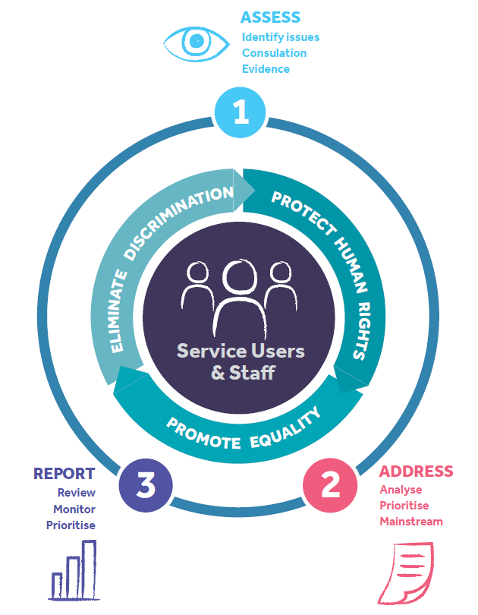
IHREC
Three-step process of implementing the Public Sector Equality and Human Rights Duty:
Assess
Address
Report
Full report available at:
https://www.ihrec.ie/documents/implementing-the-public-sector-equality-and-human-rights-duty/
Notes:
IHREC have identified a three-step approach to implementing the Public Sector Equality and Human Rights Duty. The three steps set out what a public body must do to implement the Duty in line with its legal obligation. The steps identify key actions that an organisation can undertake to assess, address, and report on equality and human rights in the context of its purpose and functions.
The three steps are:
Step 1: Assess – set out in its strategic plan an assessment of the human rights and equality issues it believes to be relevant to the functions and purpose of the body.
Step 2: Address – set out in its strategic plan the policies, plans and actions in place or proposed to be put in place to address those issues.
Step 3: Report – report on developments and achievements in its annual report.
Inclusion of the Duty in a public body’s strategic plan and annual report means that assessing and addressing equality and human rights issues becomes an ongoing process that is reviewed as part of an ongoing process.

Slide 36
Irish legal framework continued
The Equal Status Acts 2000-2015 outline the following ten grounds of discrimination:
The Acts prohibit discrimination in access to and use of goods and services, including indirect discrimination and discrimination by association, sexual harassment and harassment, and victimisation.
age | civil status
disability | family status
gender | receiving social welfare payments
membership of Traveller community | race, colour or nationality
religion | sexual orientation
Further information available at:
http://www.irishstatutebook.ie/eli/2000/act/8/enacted/en/pdf
Notes:
The Equal Status Acts 2000 -2015 (the Acts) include:
Equal Status Act, 2000
Equality Act, 2004
Equal Status (Amendment) Act 2012
Equality (Miscellaneous Provisions) Act 2015.
The Acts prohibit discrimination in access to and use of goods and services, including indirect discrimination and discrimination by association, sexual harassment and harassment, and victimisation. The Acts allow positive action to promote equality for disadvantaged persons or to cater for the special needs of persons. Discriminatory advertising is also prohibited. It is prohibited to publish, display or cause to be published or displayed, an advertisement which indicates an intention to discriminate, harass or sexually harass or might reasonably be understood as indicating such an intention.
Services provided by the State (such as the HSE, local authorities, etc.) are covered by the Acts, but there are exemptions. The main exemption is that anything required to be done by another Irish law or EU law cannot be regarded as discrimination under the Equal Status Acts. For example, it is not discrimination to refuse a social welfare payment to a person if that person is excluded from entitlement to the payment or benefit under social welfare law.

Slide 37

Discrimination
Direct discrimination happens when a person is treated less favourably than another person in the same situation under any of the grounds covered by legislation.
Discrimination by association can occur when a person is treated less favourably simply because they are associated with or are connected to another person.
Indirect discrimination happens when someone is treated in the same way as others without taking into account that person’s different situation. The individual is placed at a disadvantage as a result of blanket policies, conditions or rules which they might find hard to satisfy as a result.
Notes:
Discrimination occurs when an action or a decision is taken that treats a person or a group badly on account of their status or characteristics. There are different types of discrimination and these can impact on a person’s other rights. An action or decision is considered discriminatory if it cannot be reasonably and objectively justified. Types of discrimination include:
Direct discrimination:
Direct discrimination happens when a person is treated less favourably than another person in the same situation under any of the grounds covered by legislation. For example, direct discrimination would occur if a Muslim man in a home care setting did not receive halal meals but his Jewish neighbour received kosher meals from the same home care agency. The Muslim man is being discriminated against in the enjoyment of his right to practice his religion and this violates Article 9 of the ECHR.
Discrimination by association:
Discrimination by association can occur when a person is treated less favourably simply because they are associated with or are connected to another person. For example, if a decision is made to delay the discharge of a person with a drug addiction from hospital because they associate with other people with drug addictions, this is discrimination by association and impacts the person’s right to freedom as protected by Article 5 of the ECHR.
Indirect discrimination:
Indirect discrimination happens when someone is treated in the same way as others without taking into account that person’s different situation. The individual is placed at a disadvantage as a result of blanket policies, conditions or rules which they might find hard to satisfy as a result. For example, if activities or services are unsuitable or difficult for older people to access, this is indirect discrimination.

Slide 38
Irish legal framework continued
The Assisted Decision-Making (Capacity) Act 2015 supports decision-making by adults whose capacity is in question or may shortly be in question by enabling them to:
enter into legally binding arrangements to be supported in making decisions about their personal welfare, property and affairs
plan in advance (enduring power of attorney and advance healthcare directives).
A person is determined to lack capacity to make a particular decision if they are unable to:
understand information relevant to the decision
retain that information long enough to make a voluntary choice
use or weigh that information as part of the process of making the decision
communicate their decision (that is, by talking, writing, signing, assistive technology or any other means).
Further information available at:
http://www.irishstatutebook.ie/eli/2015/act/64/enacted/en/pdf
Notes:
The Assisted Decision-Making (Capacity) Act 2015 provides a framework to support decision-making by adults whose capacity is in question or may be called into question. The 2015 Act reforms Ireland’s existing capacity legislation, some of which had been in place since the 19th Century.
It allows adults to enter into legally binding arrangements to be supported in making decisions regarding their welfare, property and affairs. It also facilitates advanced planning by adults who have capacity, in the form of Advance Healthcare Directives* and enduring power of attorney. The Decision Support Service was established to promote the rights and interests of people who may need support with decision-making and the service registers support arrangements and supervise decision supporters. More information about this service can be found on their webpage: https://www.decisionsupportservice.ie/
The Act establishes a legal presumption of capacity and has established a functional test for assessing a person’s capacity to make a particular decision. Capacity is considered time and issue-specific and a person is determined to lack capacity to make a particular decision if they are unable to:
understand the information relevant to the decision to be made
retain that information long enough to make a voluntary choice
use or weigh that information as part of the process of making the decision
communicate their decision in whatever way they communicate (that is, by talking, writing, using sign language, assistive technology or any other means).
*An Advance Healthcare Directive is a formal record made when the directive-maker has capacity, to be used to inform family, friends and doctors of wishes for and refusals of treatment in the event that the directive-maker loses capacity. Any person aged 18 and over who has decision-making capacity can make an Advance Healthcare Directive. Currently, in the absence of a completed Advance Healthcare Directive, it is the medical team that will make these decisions.
If there is a concern that a person is unable to make certain decisions which need to be made, even with the support of a decision-making assistant, or a co-decision-maker, and that person has not previously made an enduring power of attorney or an advance healthcare directive for those particular decisions, then a decision-making representative may need to be appointed by the court to make those decisions on behalf of the person concerned. This application to the court is called a capacity application. For more information see HSE.ie FAO on Assisted Decision Making: https://www.hse.ie/eng/about/who/national-office-human-rights-equality-policy/assisted-decision-making-capacity-act/faqs/

Slide 39
Human Rights Law in Ireland
In Ireland, national courts are responsible for determining allegations of human rights violations.
Under national law, an individual can only engage the protections afforded under an international human rights law if it has been incorporated into national law. For example, the rights protected under the Irish Constitution, the ECHR Act 2003 and the EU Charter of Fundamental Rights 2012 (where EU law is applicable).
In instances where there is a lack of incorporation, individuals can make a complaint to a regional or international human rights body, such as the European Court of Human Rights.
Notes:
In Ireland, the national courts are responsible for determining allegations of human rights violations. Although Ireland has ratified a number of international human rights treaties, under Irish law an individual can only engage the protection afforded under international laws if they have been incorporated into national law. For example, the rights protected under the Irish Constitution, the European Convention on Human Rights Act, and where EU law is applicable, the EU Charter of Fundamental Rights.
This means that while Ireland ratifies international human rights treaties, ratification only gives effect to the provisions of that treaty in domestic law through Acts of the Oireachtas, or where a treaty right is already provided for under the Constitution. However, an individual can make a complaint to a regional or international human rights body such as the European Court of Human Rights.

Slide 40
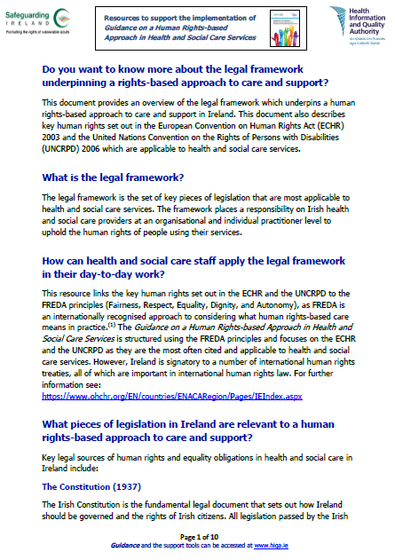
Legal framework
The legal framework is available to download here from the HIQA website.
Notes:
In addition to the Guidance on a Human Rights-based Approach in Health and Social Care Services, HIQA has published some support tools to further aid understanding and support staff to implement a rights-based approach in their work. One of these tools is a legal framework document which provides an overview of the legal framework which underpins a human rights-based approach to care and support in Ireland.

Slide 41
Section 5:
Human rights in health and social care settings
Notes:
This section sets out the legal framework underpinning human rights in health and social care settings. Specifically, this section provides details on the key rights from the Irish Constitution 1937, the ECHR Act 2003 and the UNCRPD 2006. A description of each right is presented alongside practical examples for health and social care staff of occasions within their everyday working environment when each right could arise. This section also outlines the place of human rights in the national standards developed by HIQA and in the codes and guides of conduct and ethics of different health and social care professional bodies.

Slide 42


The Irish Constitution: Key human rights articles for health and social care
Rights relevant to health and social care:
Right to a fair trial (Article 38.1)
Right to life (Article 40)
Right to be held equal before the law (Article 40.1)
Freedom from torture and ill-treatment (Article 40.3)
Right to personal liberty (Article 40.4.1º)
Freedom of expression (Article 40.6.1º)
Right to the private ownership of external goods (Article 43.1.1º)
Right to freedom of conscience and the free profession and practice of religion (Article 44.2.1)
Unenumerated rights relevant to health and social care:
Right to privacy (Article 40.3)
Right to bodily integrity (Article 40.3)
Notes:
The Irish Constitution (1937) sets out the rights of Irish citizens. The key rights (articles) from the Constitution that are often encountered in health and social care settings are:
Right to a fair trial (Article 38.1)
Right to life (Article 40)
Right to be held equal before the law (Article 40.1)
Right to freedom from torture and ill-treatment (Article 40.3)
Right to personal liberty (Article 40.4.1º)
Right to freedom of expression (Article 40.6.1º)
Right to the private ownership of external goods (Article 43.1.1º)
Right to freedom of conscience and the free profession and practice of religion (Article 44.2.1)
Irish Courts have also interpreted the Constitution as including certain other human rights, which are referred to as unenumerated rights. Unenumerated rights that are often encountered in health and social care settings are:
Right to privacy (Article 40.3)
Right to bodily integrity (Article 40.3)

Slide 43
ECHR: Key human rights articles for health and social care
Health and Social Care Settings
Right to life (Article 2)
Prohibition of torture (Article 3)
Right to liberty and security (Article 5)
Right to a fair trial (Article 6)
Right to respect for private and family life (Article 8)
Freedom of thought, conscience and religion (Article 9)
Prohibition of discrimination (Article 14)
Protection of property (Article 1, Protocol 1)
Freedom of expression (Article 10)
Notes:
Human rights are laid out in Ireland’s European Convention on Human Rights Act 2003 which includes rights from the original Convention and from the 4 additional protocols (1,4,6,7) added to the Convention at later dates. The key rights (articles) from the ECHR that are often encountered in health and social care settings are:
Right to life (Article 2)
Prohibition of torture (no one shall be subject to torture or inhuman or degrading treatment or punishment) (Article 3)
Right to liberty and security (Article 5)
Right to a fair trial (Article 6)
Right to respect for private and family life (Article 8)
Freedom of thought, conscience, and religion (Article 9)
Freedom of expression (Article 10)
Prohibition of discrimination (on any grounds, including sex, race, colour, language, religion) (Article 14)
Protection of property (Article 1, Protocol 1)
It has been argued that Article 8 (Right to respect for private and family life) is perhaps the most influential of the articles which directly affect the provision of healthcare. The incorporation of the ECHR provides a legislative basis for an individual’s right to self-determination.

Slide 44


UNCRPD: Key human rights articles for health and social care
Health (Article 25)
Respect for home and the family (Article 23)
Respect for privacy (Article 22)
Freedom of expression and opinion, and access to information (Article 21)
Living independently and being included in the community
(Article 19)
Protecting the integrity of the person (Article 17)
Freedom from torture or cruel, inhuman or degrading treatment or punishment (Article 15)
Liberty and security of the person (Article 14)
Freedom from exploitation, violence and abuse (Article 16)
General principles (Article 3)
Access to justice (Article 13)
Equal recognition before the law (Article 12)
Right to life (Article 10)
Equality and non-discrimination (Article 5)
Notes:
The rights of persons with disabilities are laid out in the United Nations Convention on the Rights of Persons with Disabilities (UNCRPD) 2006. The key rights (articles) from the UNCRPD that are often encountered in health and social care settings are:
General principles (Article 3)
Equality and non-discrimination (Article 5)
Right to life (Article 10)
Equal recognition before the law (Article 12)
Access to justice (Article 13)
Liberty and security of the person (Article 14)
Freedom from torture or cruel, inhuman or degrading treatment or punishment (Article 15)
Freedom from exploitation, violence and abuse (Article 16)
Protecting the integrity of the person (Article 17)
Living independently and being included in the community (Article 19)
Freedom of expression and opinion, and access to information (Article 21)
Respect for privacy (Article 22)
Respect for home and the family (Article 23)
Health (Article 25)
The next slides describe the key human rights set out in the Irish Constitution 1937, the ECHR Act 2003 and the UNCRPD 2006 which are relevant to health and social care. Examples of how each right might arise in different health and social care settings are also provided.

Slide 45


Key human rights articles for health and social care - definition
Right to life
Article 2 of ECHR
Article 10 of UNCRPD
Article 40 of the Irish Constitution
How might this arise in a health or social care setting?
For example, when a person’s life may be at risk and decisions are being made to withdraw life-sustaining treatments or not to resuscitate a person.
For example, when a person is experiencing suicidal thoughts.
Notes:
Right to life:
The right to life relates to Article 2 of the ECHR, Article 10 of the UNCRPD and Article 40 of the Constitution. This means that health and social care services will fulfil their obligation to protect the right to life and to refrain from unlawfully interfering with the right to life.

Slide 46
Key human rights articles for health and social care - definition
Prohibition of torture
Article 3 of ECHR
Articles 15 & 16 of UNCRPD
Article 40.3 of the Irish Constitution
How might this arise in a health or social care setting?
For example, when someone receives continuing treatment/care that causes serious harm, suffering or humiliation.
For example, when a person’s need for pain relief is not assessed or responded to.
Notes:
Prohibition of and freedom from torture or inhuman or degrading treatment or punishment:
This right relates to Article 3 of the ECHR and Articles 15 and 16 of the UNCRPD. It is relevant where a person is at risk of serious harm including where a person is neglected or cared for in a way that causes serious harm, suffering or humiliation. The right to freedom from torture and ill-treatment has been recognised by the Irish Courts as an unenumerated right and part of the right to bodily integrity under Article 40.3 of the Constitution.

Slide 47
Key human rights articles for health and social care - definition
Right to liberty and security
Article 5 of ECHR
Article 14 of UNCRPD
Article 40.4.1º of the Irish Constitution
How might this arise in a health or social care setting?
For example, having blanket policies, conditions or rules in place in residential centres can negatively impact the liberty of people using the service.
For example, when the use of a restrictive practice such as physical restraint is being considered.
Notes:
Right to liberty and security:
This right relates to Article 5 of the ECHR, Article 14 of the UNCRPD and Article 40.4.1º of the Constitution. This right means that a person’s liberty may not be interfered with without the legal power to do so based on a capacity assessment or immediate harm to self or others. Under the Constitution, no person using health or social care services will be deprived of their personal liberty save in accordance with the law.

Slide 48
Key human rights articles for health and social care - definition
Right to a fair trial and access to justice
Article 6 of ECHR
Article 13 of UNCRPD
Article 38.1 of the Irish Constitution
How might this arise in a health or social care setting?
For example, a person using services should be facilitated in accessing legal representation and or independent advocacy representation.
For example, when a person wishes to make a complaint about a service.
Notes:
Right to a fair trial and access to justice:
This right relates to Article 6 of the ECHR, Article 13 of the UNCRPD and Article 38.1 of the Constitution. This right covers all aspects of procedural fairness. Under the Constitution, no person shall be tried on any criminal charge save in due course of law.

Slide 49
Key human rights articles for health and social care - definition
Right to respect for private and family life
Article 8 of ECHR
Articles 19, 22 & 23 of UNCRPD
Article 40.3 of the Irish Constitution
How might this arise in a health or social care setting?
For example, people using services should be supported in deciding how they wish to live and whether or not to have intimate relationships and to marry.
For example, when people are supported to participate in community life and to maintain and improve their health and wellbeing.
Notes:
Right to respect for private and family life:
This right relates to Article 8 of the ECHR and Articles 19, 22 and 23 of the UNCRPD. Private life can be interpreted to include personal choices, relationships, physical and mental wellbeing and access to personal information. It includes confidentiality and privacy of medical information. It also relates to supporting a person to communicate and participate in community life. Irish courts have recognised the right to privacy as one of the unenumerated rights under Article 40.3 of the Constitution. The Constitution outlines that the state guarantees in its laws to respect, and as far as practicable, by its laws to defend and vindicate the personal rights of the citizen.

Slide 50


Key human rights articles for health and social care - definition
Freedom of thought, conscience and religion
Article 9 of ECHR
Article 3 of UNCRPD
Article 44.2.1º of the Irish Constitution
How might this arise in a health or social care setting?
For example, the values and beliefs of the person are considered when providing them with information about the risks and benefits of different treatment options.
For example, services are tailored so that they are culturally sensitive for people using them.
Notes:
Freedom of thought, conscience and religion:
This right relates to Article 9 of the ECHR, Article 3 of the UNCRPD and Article 44.2.1º of the Constitution. This right protects everyone’s right to freedom of thought, conscience and religion. It includes the right of people to put thoughts and beliefs into action either alone or in a community with others. Both religious and non-religious beliefs are protected, as is the right to change religion or belief. For a belief to be protected, it must be serious, concern important aspects of human life or behaviour, be sincerely held, and be worthy of respect in a democratic society. The Constitution states that freedom of conscience and the free profession and practice of religion are, subject to public order and morality, guaranteed to every citizen.

Slide 51
Key human rights articles for health and social care - definition
Freedom of expression
Article 10 of ECHR
Article 21 of UNCRPD
Article 40.6.1º of the Irish Constitution
How might this arise in a health or social care setting?
For example, people using services should be supported and facilitated to express their wishes for their care and support.
For example, the person’s wishes are adhered to in relation to what information is shared with their family.
Notes:
Freedom of expression:
This right relates to Article 10 of the ECHR, Article 21 of the UNCRPD and Article 40.6.1º of the Constitution. This right protects everyone’s right to expression and opinion. It relates to the freedom to seek, receive and impart information and ideas on an equal basis with others and through all forms of communication of a person’s choice. Under the Constitution, the state guarantees liberty for people to freely express their convictions and opinions, subject to public order and morality.

Slide 52

Key human rights articles for health and social care - definition
Prohibition of discrimination
Article 14 of ECHR
Articles 3, 5, 17 and 25 of UNCRPD
Article 40.1 of the Irish Constitution
How might this arise in a health or social care setting?
For example, if someone is treated differently to others under comparable circumstances on account of their characteristics (for example, on account of their age or sex).
For example, if people with different characteristics (for example, different communication abilities) are treated the same, which can lead to unequal outcomes.
Notes:
Prohibition of discrimination:
This right relates to Article 14 of the ECHR, Articles 3, 5, 17 and 25 of the UNCRPD and Article 40.1 of the Constitution. This right can relate to situations where a person is denied access to services or treatment on any ground such as sex, race, colour, language, religion, political or other opinion, national origin, association with a national minority, property, birth or other status. The Constitution states that everyone should be held equal before the law regardless of differences of capacity, physical and moral differences and differences in social function.
It also relates to people being treated differently to others under comparable circumstances on account of their characteristics, or where people with very different characteristics are treated the same. This can lead to unequal outcomes. In an Irish context, prohibition of discrimination also relates to the Equal Status Acts 2000-2015 whose grounds are narrower than those set out in the ECHR.

Slide 53

Key human rights articles for health and social care - definition
Right to protection of property
Article 1 of Protocol 1 of ECHR
Article 12 of UNCRPD
Article 43.1.1º of the Irish Constitution
How might this arise in a health or social care setting?
For example, when someone who is accessing treatment or services is able to access their possessions and property as required or requested.
For example, when a person living in a residential centre is supported to make decisions for themselves about how to spend their money.
Notes:
Right to protection of property and a right to peaceful enjoyment of possessions:
This right relates to Article 1 of Protocol 1 of the ECHR, Article 12 of the UNCPRD and Article 43.1.1º of the Constitution. A person is entitled to the peaceful enjoyment of their possessions. Possessions and property have a wide meaning, including land, houses, leases, money and personal property. A person’s property or possessions and the way they use them cannot be interfered with, except in the public interest and when subject to the conditions provided for by law. The Constitution states that a person has the right to the private ownership of external goods.

Slide 54





National standards developed by HIQA
High-level reference to human rights and a human rights-based approach to care and support is made in a number of the national standards developed by HIQA
Notes:
A number of the national standards developed by HIQA make high-level reference to human rights and a human rights-based approach to care and support, with emphasis placed on protecting and promoting people’s rights and respecting their autonomy, privacy, dignity, and their values, preferences and diversity. The standards describe high-level outcomes that services should aspire to.
Some of the national standards in which a human rights-based approach to care and support is referred to are:
National Standards for Safer Better Healthcare (v2 2024)
National Standards for Residential Services for Children and Adults with Disabilities (2013)
National Standards for Residential Care Settings for Older People in Ireland (2016)
National Standards for Safer Better Maternity Services (2016)
National Standards for Adult Safeguarding (2019).

Slide 55

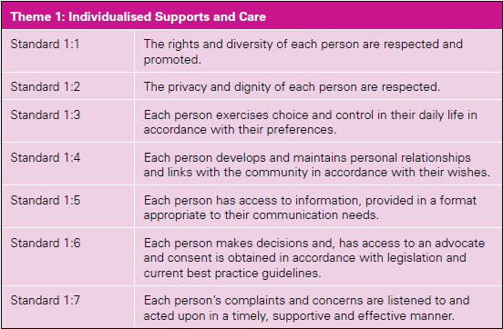
National Standards for Residential Services for Children and Adults with Disabilities (2013)
Notes:
This is an example of some of the national standards relating to human rights from the National Standards for Residential Services for Children and Adults with Disabilities (2013).
Understanding what a human rights-based approach to care and support means in the everyday work of health and social care will help services and staff to put these elements of the national standards into practice.

Slide 56


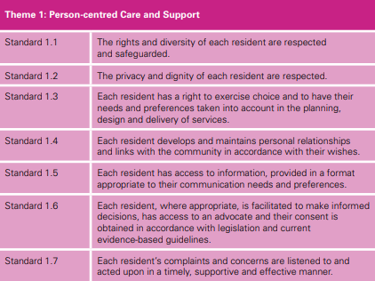
National Standards for Residential Care Settings for Older People in Ireland (2016)
Notes:
This is an example of some of the national standards relating to human rights from the National Standards for Residential Care Settings for Older People in Ireland (2016).
Understanding what a human rights-based approach to care and support means in the everyday work of health and social care will help services and staff to put these elements of the national standards into practice.

Slide 57
Codes of conduct and ethics
Respect for human rights is implicit in the codes and guides of conduct and ethics of different health and social care staff. See list of relevant codes and guides below:
Code of Professional Conduct and Ethics for Registered Nurses and Registered Midwives (Nursing and Midwifery Board of Ireland, 2025)
Guide to Professional Conduct and Ethics for Registered Medical Practitioners (Medical Council, 2024)
Social Workers Registration Board Code of Professional Conduct and Ethics (CORU, 2019)
Notes:
People working in health and social care services have a professional obligation to provide a human rights-based approach to care and support.
Respect for human rights is implicit within the codes and guides of conduct and ethics of different health and social care staff including doctors, social workers, nurses, social care workers and allied health professionals.
A human rights-based approach ensures health and social care workers’ ability to protect the human rights of people using the service they work in.
It also promotes professional accountability within the service. As a healthcare provider, if they observe a human rights violation, they have an obligation to report this.

Slide 58

Codes of conduct and ethics continued
Codes of Practice for those working in mental health services (Mental Health Commission, 2006)
Rules of Professional Conduct Incorporating Code of Ethics and Guidelines for Professional Behaviour from the Irish Society of Chartered Physiotherapists (Irish Society of Chartered Physiotherapists, 2019)
Occupational Therapists Registration Board Code of Professional Conduct and Ethics (CORU, 2019)
Dental Council Code of Practice relating to Professional Behaviour and Ethical Conduct (Dental Council, 2022)

Slide 59
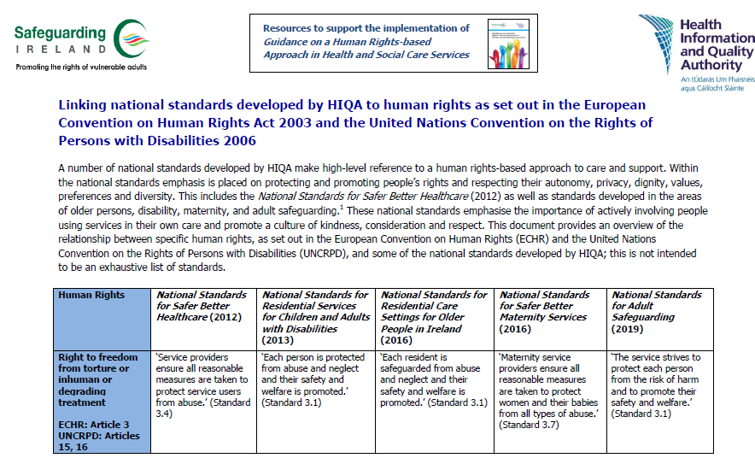
Linking national standards to human rights
Available to download here from the HIQA website
Notes:
In addition to the Guidance on a Human Rights-based Approach in Health and Social Care Services, HIQA has published some support tools to further aid understanding and support staff to implement a rights-based approach in their work.
One of these tools is a document that links the national standards developed by HIQA to human rights set out in the ECHR and the UNCRPD.

Slide 60

Section 6:
A human rights-based approach
Notes:
This section provides information on how the application of human rights principles can help ensure that the human rights of all people using health and social care services are protected and supported in day-to-day practice. This section introduces the FREDA principles (Fairness, Respect, Equality, Dignity, Autonomy). FREDA is an internationally recognised framework through which a human rights-based approach to care and support can be considered. Detailed examples of how health and social staff can support and promote each principle (Fairness, Respect, Equality, Dignity and Autonomy) are provided. These examples will allow service providers to reflect on their own work and whether or not they are upholding the human rights of people who are using the services they are providing.

Slide 61



Why do health and social care staff need to apply a human rights-based approach?
Supports the provision of person-centred care and support
Professional obligation
It’s the law
Notes:
A human rights-based approach is an important pillar of all health and social care. Human rights legislation places a duty on health and social care providers at an organisational and individual practitioner level to uphold the human rights of people using their services.
Respect for human rights is also implicit within the codes and guides of conduct and ethics of different health and social care staff including doctors, social workers, nurses, social care workers and allied health professionals. A human rights-based approach will help staff to incorporate human rights legislative requirements into their practice and to embed a human rights culture within their organisation.
High-level reference to human rights and a human rights-based approach to care and support is made in a number of the national standards developed by HIQA. Putting the human rights of the person at the centre of their care and support and promoting and upholding their rights can help to improve person-centred service delivery.

Slide 62
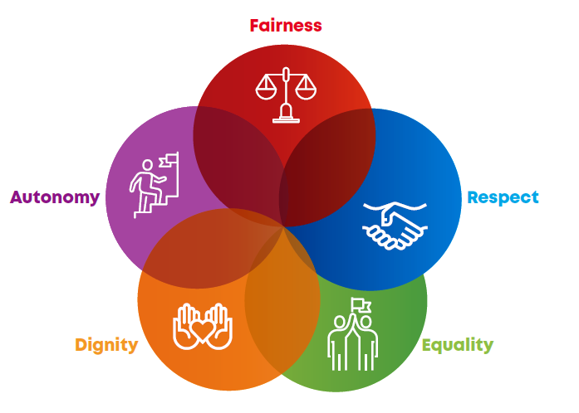
FREDA principles
It is helpful to focus on the aspects of legislation. underlying core values of human rights (Fairness, Respect, Equality, Dignity, Autonomy) rather than on the technical
Useful to think of human rights in the day-to-day work of health and social care services within the context of principles.
FREDA principles form the basics of good care.
Reference: Curtice M, Exworthy, T. FREDA: a human rights-based approach to healthcare. The Psychiatrist. 2010;34 (150-156).
Notes:
In recent years there has been an increased focus on human rights, empowerment, choice and autonomous decision-making within the health and social care sector. This focus is also reflected in the introduction of national and international human rights legislation which places an obligation on health and social care providers to uphold the human rights of people using services. Research has revealed that due to the legalistic nature and nomenclature of human rights, there remains limited understanding of the practical application of human rights among health and social care staff. A HRBA to care and support seeks to ensure that the human rights of all people using health and social care services are protected and supported in day-to-day practice and are embedded in the culture of a service. The FREDA principles (Fairness, Respect, Equality, Dignity, Autonomy) are an internationally recognised framework for considering a human rights-based approach to care. The FREDA framework seeks to ensure that health and social care providers are focusing on the underlying core values (fairness, respect, equality, dignity and autonomy) of human rights rather than on the technical aspects of human rights legislation. The principles form the basics of good care and should incorporate what service providers already do in their day-to-day work.
FREDA reference:
Curtice M, Exworthy, T. FREDA: a human rights-based approach to healthcare. The Psychiatrist. 2010;34 (150-156).

Slide 63
FREDA principles
A human rights-based approach to health and social care involves all five FREDA principles.
Principles are interdependent and should inform decisions, not determine them.
The weight given to principles is dependent on the circumstances under consideration.
Notes:
A human rights-based approach involves all five FREDA principles. While it is useful to consider each principle individually, it should be understood that they are interdependent.
The FREDA principles should be used to inform decisions, not determine them. All of the principles must inform each decision, but the weight given to each principle in reaching a conclusion will depend on the issues that are under consideration. In some instances, it may be the case that in making some decisions, a greater weight should be given to some of the principles over others. However, that does not mean that any of the principles should be disregarded in the decision-making process.

Slide 64
FREDA principles
Fairness
  Fairness means ensuring that when a decision is made with a person using a service about their care and support, that the person is at the centre of the decision-making process.
Respect
  Respect is the objective, unbiased consideration and regard for the rights, values, beliefs and property of other people. Respect applies to the person as well as their value systems.
Equality
  Equality means people having equal opportunities and being treated no less favourably than other people on the grounds set out in legislation.
Dignity
  Dignity means treating people with compassion and in a way that values them as human beings and supports their self-respect, even if their wishes are not known at the time.
Autonomy
  Autonomy is the ability of a person to direct how they live on a day-to-day basis according to personal values, beliefs and preferences.
Notes:
Over the following slides, each principle is covered in turn in more detail. For each principle, a detailed definition is given and examples of how the principle can be upheld in the day-to-day work of health and social care settings are provided.
Case studies are included which illustrate examples of the principle being upheld and not upheld in health and social care practice.
A number of self-reflection questions are also included to provide an opportunity for health and social care students or staff to think about aspects of the principle in relation to their own practice.

Slide 65


Slide 66

Fairness
NB: The principles often overlap
Fairness means ensuring that when a decision is made with a person using a service about their care and support, that the person is at the centre of the decision-making process. The person’s views are sought, listened to and weighed alongside other factors relevant to the decision. It is important that decisions are made in a way that is clear and fair, to allow others to know how they might be treated in similar circumstances. If a decision interferes with a person’s human rights, this must be legally justified, proportionate and only taken when all other alternatives have been considered.
Fairness
Equality
Autonomy
Linked to core values
Notes:
In a health or social care setting, fairness can relate to decisions being made about a person’s care and treatment. It can also relate to the process of raising and resolving concerns or complaints, or conducting a risk assessment.
Fairness is linked with the core values of equality and autonomy, in ensuring that the decision-making process is just, free from discrimination and that the person is at the centre of the decision-making process.

Slide 67
Fairness
How can you uphold fairness in your day-to-day work?
Provide relevant information to people using services and recognise their right to:
Receive information in a format and medium appropriate to their communication needs and preferences.
Receive information about their own needs, condition, treatment and care provider in a format that they can understand and in a timely manner.
Decide how much information they wish to receive.
Notes:
How might this principle be upheld in your day-to-day work?
Providing relevant information
Recognise that people who use the service have the right to receive information in a format and medium appropriate to their communication needs and preferences.
Recognise that people who use the service have the right to receive information about their own needs, condition, treatment and care provider in a format they can understand and in a timely manner. They also have the right to decide how much information, if any, they wish to receive.
Recognise that people who use the service may need assistance and support to access information and to communicate their will and preferences through a variety of mediums.
Provide people with accessible and tailored information on their treatment options, care providers and condition so that they can make independent and informed choices.
Provide people with information on their human rights and encourage them to fulfil their rights.

Slide 68
Fairness
How can you uphold fairness in your day-to-day work?
Providing relevant information:
Recognise that people using services may need assistance to access information and to communicate their will and preferences.
Provide people with accessible and tailored information on their treatment options, care providers and condition to facilitate independent and informed choices.
Provide people with information on their human rights.
Notes:
How might this principle be upheld in your day-to-day work?
Providing relevant information
Recognise that people who use the service have the right to receive information in a format and medium appropriate to their communication needs and preferences.
Recognise that people who use the service have the right to receive information about their own needs, condition, treatment and care provider in a format they can understand and in a timely manner. They also have the right to decide how much information, if any, they wish to receive.
Recognise that people who use the service may need assistance and support to access information and to communicate their will and preferences through a variety of mediums.
Provide people with accessible and tailored information on their treatment options, care providers and condition so that they can make independent and informed choices.
Provide people with information on their human rights and I encourage them to fulfil their rights.

Slide 69
Fairness
How can you uphold fairness in your day-to-day work?
Seeking consent:
Fully explain the risks and benefits of proposed and alternative options in a format they can understand.
Ensure the person using services is aware that they have a choice and they can give or withhold consent freely and without pressure.
If it is not possible for a person to make a decision, consult with the relevant decision supporter, or with the person’s family, friends or independent advocate and consider any written documentation such as an advance healthcare directive. Check with the Decision Support Service for registered decision support agreements.
Notes:
How might this principle be upheld in your day-to-day work?
Seeking consent
When seeking consent, ensure that both you and the person you are seeking consent from are actively involved in this process. Ensure that you fully explain the risks and benefits of proposed and alternative options in a format they can understand. Encourage the person to ask questions and check their understanding throughout this process.
During this process, ensure that the person knows they have a choice and they can give or withhold their consent freely and without pressure.
Where decision-making with a person is no longer possible, consult with the relevant decision supporter under the Assisted Decision-Making (Capacity) Act 2015. If there is no such decision supporter, you may consult the person’s family, friends or independent advocate and consider any written documentation or any other record (for example, an advance healthcare directive) to discover the person’s past and present will and preferences.

Slide 70
Fairness
How can you uphold fairness in your day-to-day work?
Facilitating access to and protecting personal information:
Facilitate people’s access to their personal information and information about their care and support.
Adhere to the person’s wishes regarding sharing information with family.
Seek consent before sharing information and ensure that disclosure adheres to legislation and upholds a person’s right to a private life.
Sharing information without consent can only occur if there is a safety concern and it is in line with legislation to do so.
Notes:
How might this principle be upheld in your day-to-day work?
Facilitating access to and protecting personal information
Facilitate people to access information about their care and support.
Facilitate people to access their own personal information.
Adhere to the person’s wishes in relation to what you tell their family.
Recognise that all medical records and other information recorded about a person are confidential, and ensure that any potential disclosure you make of this information respects their right to a private life and is in line with legislation.
Always seek a person’s consent before sharing their personal information. Tell the person whose information you are sharing why you are sharing it and who you will share it with. Only share the person’s personal information without their consent when you am concerned about the safety of any person and where it is in line with legislation to do so.

Slide 71
Fairness
How can you uphold fairness in your day-to-day work?
Ensuring participation during risk assessment:
When it is necessary to conduct a risk assessment, ensure there are clear and consistent processes in place.
Ensure that you conduct the risk assessment in consultation with the person using services and consider their views during the entire process.
Notes:
How might this principle be upheld in your day-to-day work?
Ensuring participation during risk assessment
Ensure that when a risk assessment is necessary, that there are clear and consistent processes in place. Ensure that this assessment is carried out in consultation with the person and takes their views into account.

Slide 72

Fairness
How can you uphold fairness in your day-to-day work?
Supporting a person to provide feedback to a service:
Facilitate an open, transparent and supportive environment that encourages people using services, their family members and carers to provide feedback, including making a complaint or raising concerns.
Fully explain to people how they can make a complaint and facilitate access to support services for those who have made a complaint.
Follow up on behalf of the person making the complaint to ensure it is responded to promptly, openly and effectively.
Notes:
How might this principle be upheld in your day-to-day work?
Supporting a person to provide feedback to a service
Facilitate a supportive, open and transparent environment that encourages people who use the service, or their family members, carers, friends or advocates, to provide feedback. This includes raising concerns, making a complaint and or giving compliments.
Actively seek feedback on your work from people you are providing care and support to.
Fully explain to people how they can make a complaint and work to lessen the fear of negative consequences from making a complaint.
Facilitate people who make a complaint to access support services, such as independent advocacy services.
Where possible, follow up on behalf of the person making a complaint and ensure that the complaint is responded to promptly, openly and effectively.

Slide 73
Fairness
How can you uphold fairness in your day-to-day work?
Supporting a person to make an Advance Healthcare Directive:
Facilitate and support a person in creating an Advance Healthcare Directive, in line with their wishes.
Ensure that the person’s Advance Healthcare Directive is used to guide their treatment and care when they no longer have the capacity to make certain decisions for themselves.
Notes:
How might this principle be upheld in your day-to-day work?
Supporting a person to make an Advance Healthcare Directive
Facilitate and support a person in the creation of an Advance Healthcare Directive, in line with their wishes.
Adhere to the Assisted Decision-Making (Capacity) Act 2015 to ensure the person’s Advance Healthcare Directive is respected, and their will and preferences guide their treatment when they no longer have the capacity to make certain decisions for themselves.
The Decision Support Service is available to promote the rights and interests of people who may need support with decision-making and register support arrangements and supervise decision supporters: https://www.decisionsupportservice.ie/

Slide 74
Fairness
How can you uphold fairness in your day-to-day work?
Minimising restrictive practices:
Uphold your duty of care to promote a restraint-free environment in the service.
Only approve a restrictive practice when there is a real and substantive risk to a person and the risk to the person of not using the practice outweighs the risk of using it.
Ensure regular review where it is deemed that a restrictive practice is necessary.
Notes:
How might this principle be upheld in your day-to-day work?
Minimising restrictive practices
Recognise what restrictive practices are and uphold your duty of care to promote a restraint-free environment in the service.
Understand that a restrictive practice should only be approved when there is a real and substantive risk to a person and the risk to the person of not using this practice outweighs the risk of using it.
Where it is deemed that a restrictive practice is required, recognise that this should be regularly reviewed.

Slide 75
Fairness
How can you uphold fairness in your day-to-day work?
Participating in decisions:
Ensure that all decisions that are made with a person are done in a way that is fair, open, timely and impartial.
Ensure that the person plays a central role in the decision-making process and is provided with adequate time and support to make the decision.
Notes:
How might this principle be upheld in your day-to-day work?
Participating in decisions
All decisions should be made with a person in a way that is fair, open, timely and impartial. Ensure that the person is supported, as far as is practicable, to make the decision in question and is given adequate time and support to do so. The person is given the opportunity to be heard and is central to the decision-making process.

Slide 76
Case study - Fairness
Example of fairness being upheld in practice:
Marie is detained under the Mental Health Act 2001 in a mental health setting. Staff caring for Marie provide her with full information on her rights, including her right to legal representation, a second independent medical review and an independent review of her detention by a mental health tribunal. Staff go through this information with Marie and ensure her understanding. Staff facilitate Marie's access to these options. Providing this information and support enables Marie to challenge any issue in relation to her detention. It also ensures that staff fulfil their duty by ensuring people using their services are not unlawfully detained.

Slide 77
Case study - Fairness
Example of fairness not being upheld in practice:
Jack has an intellectual disability and lives at home with his parents. Jack’s parents control his finances as they believe he is not capable of managing his own money. Jack attends a day centre during the week and has told staff that he would like to manage his own money. Staff are aware that Jack has never been supported to learn the skills of managing his own money. They feel he has the right to choose how he spends his own money and is capable of doing so with training and support. However, they also feel that Jack’s parents know best and do not interfere with their wishes. Both the staff and Jack’s parents have prevented Jack from managing his own money without legal justification. By making this decision without consulting Jack, the staff and Jack's parents have failed to uphold the principle of fairness.

Slide 78
Fairness: Self-reflection
When seeking consent, did I encourage people to ask questions?
Did I tailor the information I provided to people to suit their individual needs so that they could make independent choices?
Did I actively seek feedback on my work from the people I provide care and support to?
Did I uphold my duty of care to promote a restraint-free environment in the service?
Notes:
These questions will support self-reflection by students and staff. Ask students to think about their own work placement experiences and apply the questions to situations that they may have participated in or may have observed while on their placements. Ask staff to use these questions to reflect on their practice and identify areas for improvement in relation to a human rights-based approach to their day-to-day work.

Slide 79


Slide 80

Respect
NB: The principles often overlap
Respect is the objective, unbiased consideration and regard for the rights, values, beliefs and property of other people. Respect applies to the person as well as their value systems.
Respect in health and social care settings is demonstrated by communicating in a courteous manner.
People who use services must be listened to and what is important to them must be viewed as important to the service.
Respect is central to providing person-centred care and support and must be upheld regardless of a person’s impairment or loss of capacity.
Notes:
In health and social care settings, respect is shown in the actions towards a person by others and can be demonstrated by communicating in a courteous manner. This helps people feel valued through taking time to get to know them as a person and not as a number or a ‘condition’.
Respect is central to providing person-centred care and support. People who use services must be listened to, and what is important to them must be viewed as important to the service. The principle of respect must be upheld regardless of a person’s impairment or loss of capacity. Upholding the principle of respect also means that another person nominated by the person themselves, such as a family member, friend, or independent advocate, is valued and listened to.

Slide 81
Respect
How can you uphold respect in your day-to-day work?
Day-to-day communication:
Ensure that you introduce yourself properly to people using the service and clearly outline your role.
Listen to the person without judgment and provide them with all the information necessary for them to make a decision about their care and support in a format they can understand.
Consider the preferences and background of each person when providing information to them (for example, literacy, culture and religious beliefs).
Notes:
How might this principle be upheld in your day-to-day work?
Day-to-day communication
When meeting a person using the service for the first time, take the time to introduce yourself properly in order to connect with the person from the start. Ensure that the person understands what your role is.
Ensure that you take the time to listen to the person, and to understand them as an individual without judgment.
Ensure that the person has all the available information necessary to make a decision about their care and support and has had their questions answered in a way they can understand. Check the person’s understanding throughout this process. This may require the support of an interpreter or independent advocate if requested or needed by the person.
When providing information to a person, consider their preferences and their background as they describe these to you; for example previous life experience, educational attainment, literacy, culture and religious beliefs.
Avoid using technical language to describe the person’s condition or care. Instead, use the person’s own words and terms they can understand, in a format they can understand.

Slide 82

Respect
How can you uphold respect in your day-to-day work?
Person-centred care and support:
Support the person using the service to be involved in the planning of their care and support, as much as possible.
Ensure that the person’s care and support reflects their unique goals and focuses on what is important to them, how they want to live and what support they want to achieve their goals.
Ensure the person’s goals are reviewed regularly to reflect their up to date will and preferences, and that their care and support is revised accordingly.
Notes:
How might this principle be upheld in your day-to-day work?
Person-centred care and support
Respect the person as the expert on their own life and support them to be involved in planning their care and support as much as possible.
Ensure the person’s care and support reflects the goals that are unique to the person and that are meaningful to them. A person’s goals should not be dependent on available resources.
Ensure that a person’s care and support focuses on what is important to them, how they want to live and what support they want to achieve their goals. Recognise that their goals should be reviewed regularly and reflect their up-to-date will and preferences. This is reflected in planning their care and support.

Slide 83
Respect
How can you uphold respect in your day-to-day work?
Supporting relationships:
Take the time to get to know the person using the service and their preferred lifestyle.
Support the person’s wishes to maintain and develop personal relationships with family and others.
Notes:
How might this principle be upheld in your day-to-day work?
Supporting relationships
Take time to get to know the person and their preferred lifestyle.
Support the person and respect their wishes concerning maintaining and developing personal relationships with family and others. Do this with due regard for the person’s own safety.

Slide 84
Respect
How can you uphold respect in your day-to-day work?
Supporting the achievement of human rights:
Promote the person’s right to access appropriate services and support them in realising their rights.
Know who to ask for advice within the service, if you have a concern regarding a person’s human rights.
Know where to access advice outside of the service, if you have a concern regarding a person’s human rights.
Notes:
How might this principle be upheld in your day-to-day work?
Supporting the achievement of human rights
Promote the person’s right to access appropriate services.
Support a person to realise all of their rights, including the right to decide where and how they wish to live, the right to have intimate relationships, to marry and to have a family.
Know who to ask for advice or support within the service if you observe or are concerned that a person’s human rights are not being upheld. Also, know where to look for information and support outside of the service.

Slide 85
Respect
How can you uphold respect in your day-to-day work?
Respecting property and personal information:
Ensure that people using the service have access to their possessions and property as required or requested.
Respect the privacy of a person’s personal information and medical records in line with data protection legislation and only share information if there is a legal basis to do so.
Notes:
How might this principle be upheld in your day-to-day work?
Respecting property and personal information
Respect the property and possessions of the people using the service and ensure that they are able to access their possessions and property as required or requested.
Respect the privacy of a person’s personal information and medical records in line with data protection legislation. Share information only where there is a legal basis to do so.
In 2024 HIQA published National Standards for Information Management in Health and Social Care that aim to contribute to safer better care by improving the management of health and social care information. These new standards will support Ireland’s health and social care system meet requirements set out under forthcoming health information legislation at both national and European level including the Health Information Bill and the European Health Data Space. Further information in relation to the National Standards for Information Management in Health and Social Care is available at the HIQA website: https://www.hiqa.ie/reports-and-publications/standard/national-standards-information-management-health-and-social-care

Slide 86
Respect
How can you uphold respect in your day-to-day work?
Participating in developing and evaluating services:
Actively encourage people using the service to participate in the planning, design, delivery and evaluation of the service.
Ensure that the preferences of people using the service are reflected in any decisions made.
If there are changes in the service, consult with people using the service in order to consider their views and preferences.
Notes:
How might this principle be upheld in your day-to-day work?
Participating in developing and evaluating services
Encourage people to participate in the planning, design, delivery and evaluation of the service when the opportunity arises, and recognise that their preferences should be reflected in the decisions that are made.
If there are any changes in the service, recognise that it is important to consult with the people who use the service and to take their views and preferences into consideration.

Slide 87
Case study - Respect
Example of respect being upheld in practice:
Claire has an intellectual disability and lives in the community. She is attending a vocational education centre. She wishes to travel on her own by bus to her education centre each day. Claire’s circle of support, which includes her parents and support worker, recognise that this is important to her. They listen to her and do not judge her because of her disability. They respect her personal preference and look at how they can best facilitate her choice.

Slide 88

Case study - Respect
Example of respect not being upheld in practice:
Martha lives in a residential centre for older people and shares a room with another resident. Martha would like to keep her possessions and clothes in her own room but there is not enough space. Martha’s possessions and clothes are kept in a storage room down the hall and staff choose Martha’s clothes for her. Martha cannot access her possessions when she wishes. She would like to be able to personalise her room and choose her own clothes every day but she is not supported by staff to do so. Martha’s right to access her possessions and property as desired was not upheld.

Slide 89
Respect: Self-reflection
Did I take the time to listen to the person and to understand them as an individual without judgment?
Did I view the person as an expert on their own life and support them to be involved in planning their care and support as much as possible?
Did I facilitate people to access their own property and possessions?
Did I support people to maintain personal relationships with their family and others according to their wishes?
Notes:
These questions will support self-reflection by students and staff. Ask students to think about their own work placement experiences and apply the questions to situations that they may have participated in or may have observed while on their placements. Ask staff to use these questions to reflect on their practice and identify areas for improvement in relation to a human rights-based approach to their day-to-day work.

Slide 90


Slide 91

Equality
NB: The principles often overlap
Equality means people having equal opportunities and being treated no less favourably than other people on the grounds set out in legislation. In an Irish context, these grounds are: age; civil status; disability; family status; gender; membership of the Traveller community; race; colour or nationality; religion or sexual orientation.
Equality in health and social care is about ensuring that no one is discriminated against because of their status or characteristics.
Equity in health and social care means recognising that some people using services, because of their needs or circumstances, require additional help and support to achieve the best possible outcome.
Notes:
Providers have a duty of care to ensure fairness and equity for all people using services. A human rights-based approach strives to ensure that all people using services achieve the best possible outcome from the care and support they receive, regardless of their status or characteristics.

Slide 92
Equality
How can you uphold equality in your day-to-day work?
Communicating respectfully:
Communicate respectfully with all people using the service.
Ensure that each person using the service is provided with information in a way that is tailored to their individual needs and preferences.
This individualised approach should occur regardless of who they are or their communication ability.
Notes:
How might this principle be upheld in your day-to-day work?
Communicating respectfully
Communicate respectfully with all people using the service you work in and ensure that each person is provided with information in a format and medium that is tailored to their needs and preferences regardless of who they are or their communication ability.

Slide 93

Equality
How can you uphold equality in your day-to-day work?
Providing quality care and support for all:
Support people using the service you work in to get the care and support they need regardless of their status or characteristics.
Ensure that the quality of care and support that you provide is the same for everyone.
When people have more complex or varying needs, do everything you can to meet these needs so that they are able to achieve the same outcomes as others.
Notes:
How might this principle be upheld in your day-to-day work?
Providing quality care and support for all
Support people who use the service you work in to get the care and support they need regardless of their age; civil status; disability; family status; gender; membership of the Traveller community; race, colour or nationality; religion and sexual orientation. Ensure that the quality of care and support that you provide is the same for everyone.
Where people have more complex and varying needs, ensure you do everything you can to meet these needs so as to ensure they can achieve the same outcomes as others. For example, by ensuring longer appointments are provided when necessary and possible, relevant information is accessible to everyone, and everyone has information about and access to relevant population health screening programmes, for example BreastCheck.

Slide 94
Equality
How can you uphold equality in your day-to-day work?
Presuming and supporting capacity:
Always presume that a person using the service has decision-making capacity.
Never judge a person’s decision-making ability on the basis of age; civil status; disability; family status; gender; membership of the Traveller community; race, colour or nationality; religion, or sexual orientation.
Notes:
How might this principle be upheld in your day-to-day work?
Presuming and supporting capacity
Recognise that you must always presume that a person has capacity and never judge a person’s decision-making ability based on age; civil status; disability, family status; gender; membership of the Traveller community; race, colour or nationality; religion, or sexual orientation.

Slide 95
Equality
How can you uphold equality in your day-to-day work?
Promoting participation in society:
Take effective and appropriate steps to facilitate and promote a person’s full inclusion and participation in society, for example, support them in their right to:
    Vote
    Have relationships
    Participate in and have valued roles within political, religious, social, cultural and self-help or advocacy organisations.
Notes:
How might this principle be upheld in your day-to-day work?
Promoting participation in society
Take effective and appropriate steps to facilitate and promote a person’s full inclusion and participation in society, for example supporting them in their right to vote, have relationships, and participate in and have valued roles within political, religious, social, cultural and self-help or advocacy organisations.

Slide 96

Equality
How can you uphold equality in your day-to-day work?
Encouraging equality and a human rights-friendly service:
Promote a culture of equality within the service you work in, to ensure all people receive equitable care and support.
Ensure that there are no blanket policies, conditions or rules in place in the service that could negatively impact people’s human rights.
Notes:
How might this principle be upheld in your day-to-day work?
Encouraging equality and a human rights-friendly service
Recognise the importance of there being a culture of equality within the service you work in, where all people receive equitable care and support so that they can achieve the best possible outcomes.
Be aware that there should be no blanket policies, conditions or rules in place in the service you work in that can negatively impact people’s human rights, for example their right to liberty.

Slide 97
Equality
How can you uphold equality in your day-to-day work?
Facilitating access to representation:
When requested or needed, support the right of people using the service to access:
    Legal representation of their choice.
    Independent advocacy representation of their choice.
Notes:
How might this principle be upheld in your day-to-day work?
Facilitating access to representation
Support the right of people to access legal representation of their choice when requested or needed.
Support the right of people to access independent advocacy representation of their choice when requested or needed.

Slide 98
Case study - Equality
Example of equality being upheld in practice:
Annan is a Hindu. He is receiving care in an acute setting. Annan’s condition has deteriorated and staff inform Annan’s family that he is dying. Staff are aware of Annan’s beliefs and discuss with his family how they can respect these beliefs. Just before death, Annan’s family inform staff that he must be removed from his bed to the floor in keeping with his beliefs. Staff uphold the principle of equality and ensure Annan’s religious beliefs are facilitated and respected.

Slide 99

Case study - Equality
Example of equality not being upheld in practice:
Sam is in his 90s and is living in an older person’s residential centre. He likes to be able to walk down to the local shops and pub. In the centre, there is a policy in place to keep the front door locked in case residents with cognitive impairments leave the centre unattended. Sam does not have a cognitive impairment and this blanket policy impacts on his right to liberty. Sam is being discriminated against and is frustrated that he has to ask for permission each time he wishes to go outside.

Slide 100

Equality: Self-reflection
Did I always presume that a person has decision-making capacity and never judge a person’s decision-making ability based on age, disability or any other characteristic?
Did I promote a culture of equality within the service, where all people receive equitable care and support so that they can achieve the best possible outcomes?
Did I facilitate the right to legal representation and independent advocacy representation for those within the setting I work in?
Did I take effective and appropriate measures to facilitate and promote people’s full inclusion and participation in society?
Notes:
These questions will support self-reflection by students and staff.
Ask students to think about their own work placement experiences and apply the questions to situations that they may have participated in or may have observed while on their placements.
Ask staff to use these questions to reflect on their practice and identify areas for improvement in relation to a human rights-based approach to their day-to-day work.

Slide 101


Slide 102

Dignity
NB: The principles often overlap
Dignity means treating people with compassion and in a way that values them as human beings and supports their self-respect, even if their wishes are not known at the time.
All human rights are connected to human dignity.
When human dignity is upheld, it supports people using services to feel safe and improves their outcomes.
A lack of dignity can result in feelings of insecurity, guilt, shame, worthlessness, anger, frustration, lack of confidence, inadequacy and reduced motivation.
Notes:
Dignity is central to the idea of human rights and all human rights are connected to human dignity.
When human dignity is upheld in health and social care settings, it supports people using services to feel safe and improves their outcomes.
It also improves working relationships and can result in positive outcomes for staff.
Lack of dignity is a common theme in examples of abuse and neglect in health and social care settings, including malnutrition and dehydration; physical, psychological or sexual abuse; ignoring calls for help; unchanged bed sheets; not feeding people properly; pressure ulcers; poor personal care; being made to wear incontinence wear when unnecessary; restrictive practices; and bullying, patronising and condescending attitudes.
A lack of dignity can result in feelings of insecurity, guilt, shame, worthlessness, anger, frustration, lack of confidence, inadequacy and reduced motivation. It can also result in reduced quality of care and support and decreased satisfaction among staff.

Slide 103
Dignity
How can you uphold dignity in your day-to-day work?
Meeting basic needs:
Ensure that people’s basic needs are met, for example food, clothing, personal care, and feeling safe, comfortable, valued and respected.
Ensure that people have access to appropriate food and hydration and offer assistance if support is required to eat or drink.
Ensure that people are not neglected or treated in any way that is likely to cause harm.
Notes:
How might this principle be upheld in your day-to-day work?
Meeting basic needs
Ensure people using the service have their basic needs met, for example food, clothing, personal care (including assisting with oral and dental care), and that they feel safe, comfortable, valued and respected.
Ensure that they have access to appropriate food and hydration so that they do not suffer from malnutrition or dehydration. Ensure that food and drink is always within a person’s reach and offer assistance if support is required to eat or drink.
Ensure that people are not neglected or treated in any way that is likely to cause harm. For example, make sure that no one is left in a soiled state.

Slide 104
Dignity
How can you uphold dignity in your day-to-day work?
Maintaining privacy:
Ensure to respect the privacy of people when supporting them with their intimate care and during physical examinations.
Make all efforts to ensure a person’s privacy when discussing their health and social care with them.
Avoid rushing tasks so as not to impact a person’s privacy and dignity.
Notes:
How might this principle be upheld in your day-to-day work?
Maintaining privacy
Ensure to respect the privacy of people when supporting them to undress, bathe and dress.
Discuss a person’s health and care in a private setting or, in a situation where there is no private space available, make all efforts to ensure their privacy, for example lower your voice or move closer to the person so as not to be overheard by others.
Ensure to properly cover a person during a physical examination or when you are assisting them with their intimate care.
Avoid rushing a task so as not to impact their privacy and dignity.

Slide 105
Dignity
How can you uphold dignity in your day-to-day work?
Communicating sensitively:
Address people using the service by their preferred name and gender pronoun and communicate with them in a way that respects their individuality, dignity and personal identity.
If a person is unable to communicate verbally, work with them and with others who know them, as well as with other team members, to understand the best way to communicate with them.
Take care not to patronise people, regardless of their age or other status.
Maintain a person’s dignity at all times, even if they are unconscious.
Notes:
How might this principle be upheld in your day-to-day work?
Communicating sensitively
Address and refer to people who use the service by their preferred name and gender pronoun.
Communicate with people in a way that acknowledges and respects their individuality, dignity and personal identity. If a person is unable to communicate verbally, work with the person and with others who know them, as well as with other team members, to understand the best way to communicate with them. Strive to make sure that they understand you and that you understand them.
Take care not to patronise or be condescending towards a person regardless of their age or any other status.
Ensure that a person’s dignity is maintained at all times even if they are unconscious, and unable to communicate.

Slide 106
Dignity
How can you uphold dignity in your day-to-day work?
Supporting a person’s preferred lifestyle:
Enquire about a person’s preferred lifestyle, including routines, pets, personal care, clothing preferences, religious and cultural preferences.
Facilitate their lifestyle as much as possible in their care and support.
Where a person’s preferred lifestyle is not easily known, consult with others who know them to ascertain their past and present preferences.
Notes:
How might this principle be upheld in your day-to-day work?
Supporting a person’s preferred lifestyle
Always enquire about a person’s preferred lifestyle, including routines, pets, personal care, clothing preferences, religious and cultural preferences, and facilitate their lifestyle as much as possible. This can be something as simple as providing preferred options during meal times. Where a person’s preferred lifestyle is not easily known, consult with others who know them to ascertain their past and present preferences.

Slide 107
Dignity
How can you uphold dignity in your day-to-day work?
Minimising restrictive practices:
Ensure that a person is supported to move around freely, for example the person is not confined to a bed or a chair when this is unnecessary.
Notes:
How might this principle be upheld in your day-to-day work?
Minimising restrictive practices
Ensure that a person is supported to move around freely. For example, ensure that a person is not confined to a bed or chair when this is unnecessary.

Slide 108
Case study - Dignity
Example of dignity being upheld in practice:
Fiona is pregnant and has started to experience depression. She has been referred to a midwife with mental health expertise in her local maternity hospital. Fiona does not want others finding out about her depression. The mental health midwife ensures that her privacy is respected at all times. When Fiona is called for her appointment, although the room is a few minutes walk from the waiting area, the midwife ensures they are in the consultation room and cannot be overheard before they begin talking.

Slide 109
Case study - Dignity
Example of dignity not being upheld in practice:
Daniel has difficulties communicating verbally and is admitted to hospital with complications associated with his diabetes. The healthcare practitioners do not speak to Daniel about what care they are providing to him or what interventions are being carried out, because he cannot communicate verbally. In addition, staff do not assess whether Daniel can understand them and if there are other ways to communicate with him. Daniel is not provided with additional support to help him communicate with staff and therefore is not involved in any decisions regarding his care.

Slide 110
Dignity: Self-reflection
Did I ensure that all people I provided support to had their basic needs met, for example that they felt safe, comfortable, valued and respected?
Did I avoid discussing care and support in public areas and did I ensure that phone calls and meetings were held behind closed doors?
Did I take the time to get to know a person’s preferred lifestyle and did I facilitate their lifestyle as much as possible?
Did I ensure that I did not infantilise or patronise people using the service regardless of their age or any other status?
Notes:
These questions will support self-reflection by students and staff. Ask students to think about their own work placement experiences and apply the questions to situations that they may have participated in or may have observed while on their placements.
Ask staff to use these questions to reflect on their practice and identify areas for improvement in relation to a human rights-based approach to their day-to-day work.

Slide 111


Slide 112

Autonomy
NB: The principles often overlap
Autonomy is the ability of a person to direct how they live on a day-to-day basis according to personal values, beliefs and preferences. In a health and social care setting, autonomy involves the person using a service making informed decisions about their care, support or treatment.
Health and social care staff have a key role in supporting people to make their own decisions regarding their treatment or care.
Supporting autonomy is a fundamental aspect of person-centred care and support, and involves meaningful communication.
Respecting a person’s autonomy can involve negotiation and compromise when a person’s will and preferences impact on the rights, care and safety of others.
Notes:
In a health and social care setting, people may require different levels of support to assert their autonomy and make their own decisions. This means staff have a key role in this process. The ability to be autonomous, and make decisions, can and must be supported and developed. Respecting and supporting autonomy is important in health and social care as it is a fundamental aspect of person-centred care and support.
Respecting a person’s autonomy in health and social care involves meaningful communication. It is important to recognise that it can also involve negotiation and compromise when a person’s will and preferences impact on the rights, care and safety of others. A person’s autonomy may also be impacted when there is a legal basis for it not to be upheld.

Slide 113
Autonomy
How can you uphold autonomy in your day-to-day work?
Seeking consent:
Communicate clearly and effectively with the person using the service by using language or other means of communication that they can understand.
Provide the person with adequate and relevant information about their care and support options so that they can make a fully-informed decision.
Notes:
How might this principle be upheld in your day-to-day work?
Seeking consent
Ensure that you communicate clearly and effectively with the person using the service. Use language or other means of communication that they can understand and do not use medical or social care jargon. Always support the person in their decision-making process in relation to their care and support.
Ensure that the person is provided with adequate and relevant information about their care and support options, including the advantages and disadvantages of each option, to ensure they can make a fully-informed decision.

Slide 114

Autonomy
How can you uphold autonomy in your day-to-day work?
Understanding and respecting a person’s will and preferences:
Understand and regularly review the will and preferences of a person in order to promote and support their autonomy when assisting in their decision-making process.
Support the person’s choice in relation to care and support, regardless of whether or not you believe it is the right decision.
Seek advice or support if you observe or are concerned about undue influence on a person’s decision-making.
Notes:
How might this principle be upheld in your day-to-day work?
Understanding and respecting a person’s will and preferences
Ensure that you understand and regularly review the will and preferences of a person to ensure that you can promote and support their autonomy when assisting in or supporting their decision-making process.
In order to make sure a person’s autonomy is upheld, support their choice in relation to care and support, regardless of whether or not you believe it is the right decision. Understand that a person has a right to make a decision that appears to you to be unwise.
Ask for advice or support if you observe or are concerned about undue influence on a person’s decision-making.

Slide 115

Autonomy
How can you uphold autonomy in your day-to-day work?
Supporting decision-making capacity and responding accordingly:
Always presume a person has decision-making capacity and fully support them to make a decision for themselves.
Do not presume that a person lacks capacity because they make a decision that seems unwise to you.
If a person has been assessed as lacking capacity and if an intervention is urgent and it is unlikely the person will recover capacity in the short-term, ensure any action taken is in line with the Assisted Decision-Making (Capacity) Act 2015.
Notes:
How might this principle be upheld in your day-to-day work?
Supporting decision-making capacity and responding accordingly
Always presume a person has capacity and work to fully support them to make a decision for themselves.
Recognise that you cannot presume that a person lacks capacity in relation to a certain matter or decision on the basis that the decision they make seems unwise to you.
If a person has been assessed as lacking capacity under the Assisted Decision-Making (Capacity) 2015 in relation to a certain matter or decision and if an intervention is urgent and it is unlikely that the person will recover capacity to make a decision in the short-term, ensure that any action taken is proportionate to the seriousness of the issue at hand and minimises any restrictions to their human rights. In addition, you should make every effort possible to ensure that their past and present will and preferences have been determined. This includes considering the views of any person named by the person themselves, whether a family member, a friend, or independent advocate, and consider any written documentation or any other record (such as an advance healthcare directive) and ensure that any decision made takes these into account.
In addition, the Decision Support Service should be contacted. This service was established under the Assisted Decision-Making (Capacity) Act 2015 and provides support for people who face difficulties and need support exercising their decision-making capacity. The Service, as part of its role, regulates and registers decision support arrangements and supervises the actions of decision supporters.
Recognise that capacity is time and issue specific. Although a person might have been assessed as not having capacity to make a decision at a particular moment in time, understand that when it is relevant and possible for you to do so, you should make sure that their capacity is reviewed and that changes are made accordingly.
Recognise that where capacity is assessed as limited that the person should be supported to increase capacity to make an informed decision or reduce a restriction through skills development, in line with their preferences.

Slide 116
Autonomy
How can you uphold autonomy in your day-to-day work?
Supporting decision-making capacity and responding accordingly:
Understand that decision-making capacity is time and issue specific and where a person has been assessed as lacking capacity, ensure their capacity is reviewed when it is relevant and possible to do so.
Where capacity is assessed as limited, support the person to increase capacity or reduce a restriction through skills development.
Notes:
How might this principle be upheld in your day-to-day work?
Supporting decision-making capacity and responding accordingly
Always presume a person has capacity and work to fully support them to make a decision for themselves.
Recognise that you cannot presume that a person lacks capacity in relation to a certain matter or decision on the basis that the decision they make seems unwise to you.
If a person has been assessed as lacking capacity under the Assisted Decision-Making (Capacity) Act 2015 in relation to a certain matter or decision and if an intervention is urgent and it is unlikely that the person will recover capacity to make a decision in the short term, ensure that any action you take is proportionate to the seriousness of the issue at hand and minimises any restrictions to their human rights. In addition, you should make every effort possible to ensure that their past and present will and preferences have been determined. This includes considering the views of any person named by the person themselves, whether a family member, a friend, or independent advocate, and consider any written documentation or any other record (such as an advance healthcare directive) and ensure that any decision made takes these into account.
Liaise with the Decision Support Service. This service was established under the Assisted Decision-Making (Capacity) Act 2015 and provides support for people who face difficulties and need support exercising their decision-making capacity. The Service, as part of its role, regulates and registers decision support arrangements and supervises the actions of decision supporters.
Recognise that capacity is time and issue specific. Although a person might have been assessed as not having capacity to make a decision at a particular moment in time, understand that when it is relevant and possible for you to do so, you should make sure that their capacity is reviewed and that changes are made accordingly.
Recognise that where capacity is assessed as limited that the person should be supported to increase capacity to make an informed decision or reduce a restriction through skills development, in line with their preferences.

Slide 117
Autonomy
How can you uphold autonomy in your day-to-day work?
Minimising restrictive practices:
Always explore options other than restrictive practices when a person displays behaviour that challenges.
When a restrictive practice is used, ensure that it is proportionate to the behaviour it is being used to restrict, is the least restrictive; is applied for shortest possible time; and is subject to a timely review.
Notes:
How might this principle be upheld in your day-to-day work?
Minimising restrictive practices
Always explore options other than restrictive practices when a person displays behaviour that challenges, or behaviour that is disruptive. Ensure that when a restrictive practice is used, it is proportionate to the behaviour it is being used to restrict; is the least restrictive option; is applied for the shortest possible time; and is subject to a timely review. You should understand that reviews are also an opportunity to trial alternatives that are less restrictive and or for a shorter period of time.

Slide 118
Autonomy
How can you uphold autonomy in your day-to-day work?
Supporting participation:
Actively encourage the participation of people in the assessment, planning, delivery and evaluation of their care and support.
Be aware that a person’s wishes to engage in the process may change over time and where a person chooses not to engage, regularly review their interest to re-engage.
Notes:
How might this principle be upheld in your day-to-day work?
Supporting participation
Encourage the participation of people in the assessment, planning, delivery and evaluation of their care and support as much as possible and as much as the person wishes. Recognise that a person’s wishes to engage may change over time and where a person chooses not to engage, regularly review their interest to re-engage.

Slide 119
Autonomy
How can you uphold autonomy in your day-to-day work?
Supporting independent living:
Support people as much as possible to maintain or develop their ability to live independently.
Support people to develop the skills necessary for community living.
Notes:
How might this principle be upheld in your day-to-day work?
Supporting independent living
Ensure that you support people as much as possible to maintain or develop their ability to live independently and develop the skills necessary for community living.

Slide 120
Case study - Autonomy
Example of autonomy being upheld in practice:
Jane has a physical disability and had been living in a residential centre. However, she wished to live at home. Following discussion and assessment, her support team in the residential centre felt that this was not ideal, as she was considered to be a person with high needs. Jane and the team discussed this and she understood and agreed that she would not receive the same level of care at home that she would have in the residential centre. Jane’s wishes were respected and she was supported to take a measured risk. This was not about discharging Jane from the service, but about supporting her to transition from the residential centre and continuing to provide her with care in a different setting. Staff supported Jane in exercising her autonomy by understanding and respecting Jane’s will and preferences and supporting her to live independently. Staff communicate with Jane on a regular basis to make sure that her new living situation is working well for her and identify any additional supports that she may need.

Slide 121

Case study - Autonomy
Example of autonomy not being upheld in practice:
Richard is an inpatient in an acute setting; he is suffering from complications associated with Parkinson’s disease. Richard likes to eat quickly and on more than one occasion he has nearly choked on his meal. Staff assessed Richard’s situation and prescribe that Richard’s food be cut up. Richard was not consulted regarding this decision. He was not provided with information in the right format to ensure his understanding of the process and he was not consulted with regarding the next steps in his care plan. Richard does not want his food to be cut up and wishes he had been involved in the decision-making process and supported to participate in the planning of his care.

Slide 122
Autonomy: Self-reflection
Did I support people using the service in their choice for their care and support regardless of whether or not I believed it was the right decision?
When a person was assessed as lacking decision-making capacity, did I ensure that their capacity was continuously reviewed and that changes were made according to the outcome of the review?
Did I ensure that when a restrictive practice was used, that it was proportionate to the behavior it was being used to restrict; it was the least restrictive option; it was applied for the shortest time possible; and it was subject to a timely review?
Notes:
These questions will support self-reflection by students and staff. Ask students to think about their own work placement experiences and apply the questions to situations that they may have participated in or may have observed while on their placements. Ask staff to use these questions to reflect on their practice and identify areas for improvement in relation to a human rights-based approach to their day-to-day work.

Slide 123
Section 7:
Case studies, practical exercise and useful resources
Notes:
This section provides a number of extended case studies which depict examples of all five FREDA principles in practice across different health and social care settings. A list of additional resources and a list of key pieces of legislation which may be useful for students or for staff working in health and social care settings are also included at the end of this section.

Slide 124
Case study – Jim
Respect is upheld. Patrick takes the time to introduce himself properly to Jim when they first meet and he speaks to him in a way that Jim can understand.
Jim has dementia and lives in a residential centre for older people. Patrick, a nurse, has recently started work in the centre.
On his first day, Patrick introduces himself to Jim and greets him warmly. He sits with Jim and asks him how he is. He speaks slowly to Jim and uses simple language. Throughout his first week at the centre, Patrick familiarises himself with Jim’s notes; reading about the hobbies Jim once engaged in, his family and his views and beliefs. Patrick is aware of various techniques which could be used in order to make Jim as comfortable as possible, such as reminiscence therapy and art therapy. Patrick speaks to Jim’s family and friends and listens to their opinions on the various interventions that may help him.
Patrick wants to build a relationship with Jim but this can be challenging as Jim frequently becomes confused and angry. This occurred on one occasion when Patrick assisted Jim in changing his clothes and Jim became frustrated. Although Patrick was under time pressure, he respected Jim’s frustrations and gave him time before trying again. Patrick ensures Jim’s privacy is protected when performing intimate care tasks.
Autonomy is upheld. Patrick makes every effort to determine Jim’s individual needs and preferences. He also talks to Jim’s family and friends and listens to their suggestions based on their personal knowledge of Jim.
Dignity is upheld. Patrick does not rush tasks that affect Jim’s personal privacy. He communicates with Jim in a way that respects Jim’s individuality and personal needs and preferences.
Notes:
This section includes three extended case studies that set out in different health and social care settings the five FREDA principles being upheld or not upheld in practice. The first case study is about Jim, who has dementia and lives in a residential centre for older people.

Slide 125
Case study – Jim continued
Jim has told Patrick that he would like his wife to be kept up-to-date about the care he is receiving. With Jim’s consent, Patrick meets with Jim’s wife regularly to keep her informed about Jim’s care. Patrick also views these meetings as opportunities to get feedback from Jim’s wife about the care and support provided to Jim.
By spending time with Jim, Patrick begins to understand him more – learning about his history, what works for him, what has not worked for him, and what triggers certain emotions. Jim’s notes reveal that he enjoys company and Patrick works to understand how to interact with Jim on a level he feels comfortable with. Patrick initially engaged with Jim as he would with any other person using the service by making conversation. However, this had put a lot of strain on Jim. Every subsequent interaction Patrick has with Jim involves him being present and caring, but not necessarily vocal. Jim likes art and once a week Patrick arranges outings with him to a local art gallery. When communicating with Jim, Patrick makes remarks rather than asking Jim questions, placing no onus on Jim to answer him or engage with him if he would prefer not to. These short interactions allow Patrick to build a more trusting relationship with Jim.
Fairness is upheld. Patrick follows Jim’s wishes in relation to sharing information about his care. Patrick welcomes feedback on the care and support he provides to Jim.
Equality is upheld. It is important to understand the impact that treating Jim the same as everyone else would have on him. Patrick understands that this could lead to indirect discrimination.

Slide 126
Case study – Claudia
Claudia is in her late 50s and has a physical disability. She lives in a residential care centre. She recently saw a TV advertisement about BreastCheck and wondered why she had not yet received a letter regarding this.
Claudia asked the nurse on duty why she had not received a letter and even though the nurse did not know, she did not follow up on Claudia’s query. Claudia found it upsetting that her query was not taken seriously and spoke to her support worker, Fiona, about her concerns. Fiona found out that the centre had received the letter but had discarded it. Claudia arranged an appointment with the resident GP to discuss the matter. At Claudia’s request, Fiona accompanied Claudia to her appointment.
Claudia explained what had happened and although her GP did not know how or why this had happened, he explained to her how she could access the screening programme and provided her with written information about it. Claudia was glad she had visited the GP as she felt she had been listened to and taken seriously.
Respect was not upheld. Claudia’s nurse did not provide adequate answers to her questions and did not provide her with information on the options available to her. She was not supported to access and realise her rights.
Dignity was not upheld. Claudia was not taken seriously by the nurse.
Equality was not upheld as Claudia’s care did not promote equity of outcomes. It is important that her will and preferences are respected in the same way as others, regardless of her characteristics or status.
Notes:
The second extended case study is about Claudia. Claudia has a physical disability and lives in a residential care centre.

Slide 127
Case study – Claudia continued
Claudia wanted to make a complaint about not receiving the letter as she felt that her health had potentially been put at risk. However, Claudia did not know how to do this as there was no information available in the centre. She asked for assistance from Fiona, who helped her write a letter of complaint to the centre manager. The centre manager sent a letter of apology to Claudia, explaining what had happened to her letter from BreastCheck and stating that all efforts would be made to ensure she received a date for her screening appointment as soon as possible. Claudia was also reassured that procedures would be put in place to prevent this from happening to anyone in the centre again.
Fairness was upheld in that Claudia was supported in making a complaint by her care worker. The centre manager upheld fairness by making efforts to rectify the situation by putting proper procedures in place.
Autonomy was upheld. Claudia was supported throughout the process by her support worker who ensured her will and preferences are central to it.

Slide 128
Case study – Mark
Mark is an 80-year-old adult with hearing loss living in a nursing home. Over the past number of years, Mark’s sight has deteriorated and he is now legally blind. Mark’s wife died a number of years ago and he does not have any children. He is close to his niece, Marie, who visits him regularly. The resident GP comes to see Mark, as he is experiencing severe abdominal pain and vomiting. His GP sends him to the emergency department for further tests, and Mark is diagnosed with appendicitis.
The plan is to proceed with surgery to remove Mark’s appendix. Mark’s doctor, James, meets with him in his six-bed ward when Marie is visiting him. James introduces himself and asks Mark if he would like anyone to be with him when he receives information about his surgery. Mark says that he would like his niece to stay with him when discussing his care. James closes the curtains halfway around his bed. He knows that Mark has difficulty hearing and therefore moves closer to speak with Mark explaining that he will need surgery.
Respect was upheld. Mark was provided with information about his condition and treatment, and had his questions answered in a way he understands. Mark’s doctor showed respect in addressing his hearing loss by moving closer to speak with him.
Equality was upheld when Mark’s will and preferences were respected regardless of his characteristics or status.
Dignity was upheld. He was communicated with in a way that acknowledged his personal identity and individuality. However, by not closing the curtain fully, his physical privacy was compromised.
Notes:
The third extended case study is about Mark. Mark is an 80-year-old adult who has hearing loss and is living in a nursing home.

Slide 129

Case study – Mark continued
James ensures he follows the necessary guidelines for good practice in seeking consent to treatment. He explains to Mark the benefits and risks of the proposed surgery and the consequences of not having surgery. He explains the procedure using simple language and avoids complex medical terminology where possible. He asks Mark how he would like to receive the information. As Mark has difficulties with his sight and hearing, he is provided all relevant written information about the procedure in large bold print which he is able to read. Mark is fully informed and actively involved in the process. James encourages him to ask questions and he checks Mark’s understanding throughout the discussion. He gives Mark time to reflect on the information and to think of further questions to ask.
Mark is anxious about the surgery and has a number of questions. Mark’s doctor spends time answering these questions clearly, which eases his fears. Mark gives his consent to undergo surgery for his appendicitis. James is aware that Mark came to this decision by himself.
Fairness was upheld as there was a clear and fair process in place governing informed consent and Mark was provided with accessible information in a format of his choice on his treatment options. Mark was supported to participate in the decision-making process.
Mark’s autonomy was upheld throughout this process, resulting in him making an informed decision to consent to surgery freely and without duress.

Slide 130
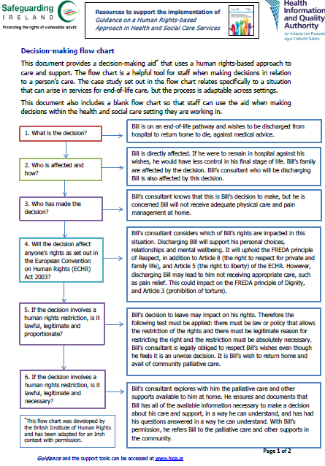
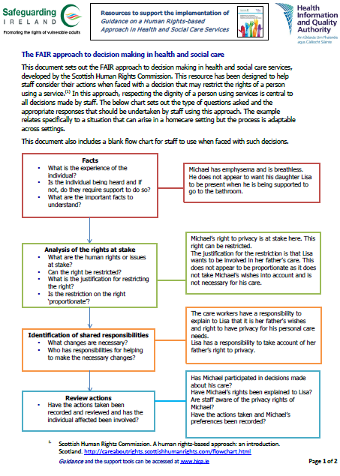
Decision-making flow charts
Available to download here from the HIQA website
Available to download here from the HIQA website
Notes:
HIQA has published some support tools to further aid understanding and support staff to implement a rights-based approach in their work, including two decision-making aids that use a human rights-based approach. As demonstrated in the practical exercise, these decision-making aids are helpful tools for staff when making decisions in relation to a person’s care, particularly when faced with a decision that might restrict the rights of a person using a service. These flow charts are available to download from the HIQA website.

Slide 131


Advocacy Resources
HIQA has developed an online learning course, video and booklet on ‘The Fundamentals of Advocacy in health and social care’
Advocacy is about ensuring person-centred care by placing the person at the centre of any decision-making about their lives and their care, which is central to the FREDA principles, especially autonomy.
The advocacy resources can be found here.
Notes:
Advocacy is a key part of the role of all health and social care staff in Ireland. Advocacy is about supporting and empowering people to communicate their will and preference, securing their human rights, or representing their interests.
Advocacy is about ensuring person-centred care by placing the person at the centre of any decision-making about their lives and their care, which is central to the FREDA principles, especially autonomy. There are times when it is necessary to involve an independent advocate to support a person, staff should support people to access these services when required. HIQA developed an online learning course, booklet and educational video on The Fundamentals of Advocacy in health and social care. Advocacy is a key element in all national standards published by HIQA.

Slide 132


Practical exercise
Notes:
The following three slides provide a practical exercise that may be useful for students or staff undertaking training. A case study is presented on the following slide whereby decisions are made regarding the support received by a person using services. After considering the case study, ask students or staff to work their way through the decision-making flow chart that is also included in this section. The decision-making flow chart will help students or staff determine whether or not a human rights-based approach was implemented in the decisions that were made in the case study.

Slide 133

Case study – Jack
Jack has an intellectual disability and lives at home with his parents. Jack’s parents control his finances as they believe he is not capable of managing his own money.
Jack attends a day centre during the week and has told staff that he would like to manage his own money. Staff are aware that Jack has never been supported to learn the skills of managing his own money. They feel he has the right to choose how he spends his own money and is capable of doing so with training and support.
However, they also feel that Jack’s parents know best and do not interfere with their wishes. Both the staff and Jack’s parents have prevented Jack from managing his own money without legal justification. By making this decision without consulting Jack, the staff and Jack's parents have failed to uphold the principle of fairness.

Slide 134
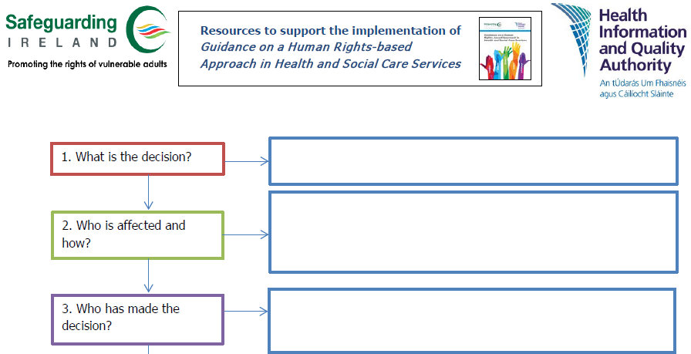
Decision-making flow chart
Notes:
Ask the students or staff to work through Jack’s case study using the above decision-making flow chart. This flow chart will help students and staff determine whether or not a human rights-based approach was implemented in Jack’s situation. The flow-chart is divided over this slide and the next slide.

Slide 135
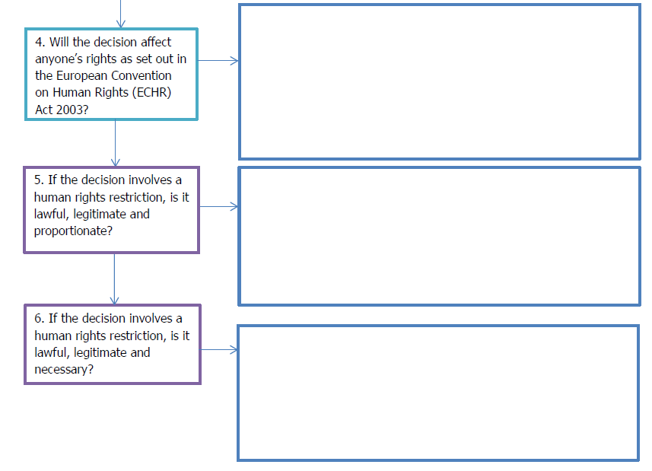
Decision-making flow chart

Slide 136
Human rights complaints procedure in Ireland
Irish citizens have a number of rights and remedies available to them if they feel their human rights have been violated. The Irish courts are responsible for determining allegations of human rights violations.
While Ireland has ratified a number of international human rights treaties, under Irish law an individual can only engage the protections afforded under international law if they have been incorporated into national law.
Irish citizens can bring a case to the European Court of Human Rights if domestic remedies have been exhausted.
IHREC provides a ‘Your Rights’ service, which provides individuals with information on their rights and the remedies available to them under national equality and human rights law.
Further information available at:
https://www.ihrec.ie/your-rights/
Notes:
IHREC provides a ‘Your Rights’ service which provides individuals with information on their rights and the remedies available to them under equality and human rights law in Ireland. This includes information on:
Work-related discrimination
Discrimination in relation to goods and services
Discrimination in relation to education
Human rights protections under Irish law

Slide 137
Useful resources
Resources to aid understanding and support implementation of a human rights-based approach in health and social care services:
Guidance on a Human Rights-based Approach in Health and Social Care Services
Frequently asked questions (FAQ) about the Guidance
An overview of the legal framework underpinning a HRBA
Decision-making flow chart for health and social care staff
FAIR Approach to decision making for health and social care staff
Document linking national standards to human rights
Background document (evidence review)
Statement of outcomes (stakeholder involvement report)
Guidance and additional resources available to download from the HIQA website and the HIQA Learning Hub
Notes:
In addition to the Guidance on a Human Rights-based Approach in Health and Social Care Services, HIQA has published a number of resources to aid understanding and support implementation of the guidance. These resources include:
Frequently asked questions about the Guidance on a Human Rights-based Approach in Health and Social Care Services.
An overview of the legal framework which underpins a human rights-based approach to care and support in Ireland.
Decision-making flow chart that uses a human rights-based approach to care and support and which is a helpful tool for staff when making decisions in relation to a person’s care.
FAIR Approach to decision making in health and social care which was developed by the Scottish Human Rights Commission to help staff consider their actions when faced with a decision that may restrict the rights of a person using a service.
A document linking the National Standards developed by HIQA to human rights set out in the ECHR Act 2003 and the UNCRPD 2006.
The Background document detailing the international and national evidence that was used to inform the development of the guidance. In addition to reviewing national and international legislation on human rights, HIQA reviewed standards, guidelines and supporting tools and resources in other jurisdictions.
The Statement of Outcomes report which outlines the feedback that was received during focus group discussions and public consultations, and how this feedback informed the development of the guidance.

Slide 138
Further reading
Published documents:
National Consent Policy Health Service Executive, 2022 | HIQA Learning Hub
Guidance on promoting a care environment that is free from restrictive practice: Disability Services HIQA, 2023 | Guidance on promoting a care environment that is free from restrictive practice: Older People’s Services HIQA, 2023
Information for staff on Diversity, Equality and Inclusion Health Service Executive | National standards and guidance developed by HIQA HIQA 2021
The Fundamentals of Advocacy in Health and Social Care HIQA, 2023 | The Decision Support Service Codes of practice and guidance materials
Notes:
This is a list of published resources that may be useful for students and for staff working in health and social care services. This list is not exhaustive and does not include all the resources that may be relevant to all staff. Staff should seek and identify the best available, and most current evidence relevant to their work.

Slide 139
Further reading
Key legislation:
Universal Declaration of Human Rights 2006 | European Convention on Human Rights 2003
European Convention on Human Rights Act 2003 | United Nations Convention on the Rights of Persons with Disabilities 2006
The Equal Status Acts 2000-2015 Homepage: www.irishstatutebook.ie | Assisted Decision-Making (Capacity) Act 2015
The Irish Human Rights and Equality Commission Act 2014 | The Charter of Fundamental Rights of the European Union 2000
Notes:
This is a list of key legislation that may be useful for students and for staff working in health and social care services. This list is not exhaustive and does not include all the legislation that may be relevant to all staff.

Slide 140
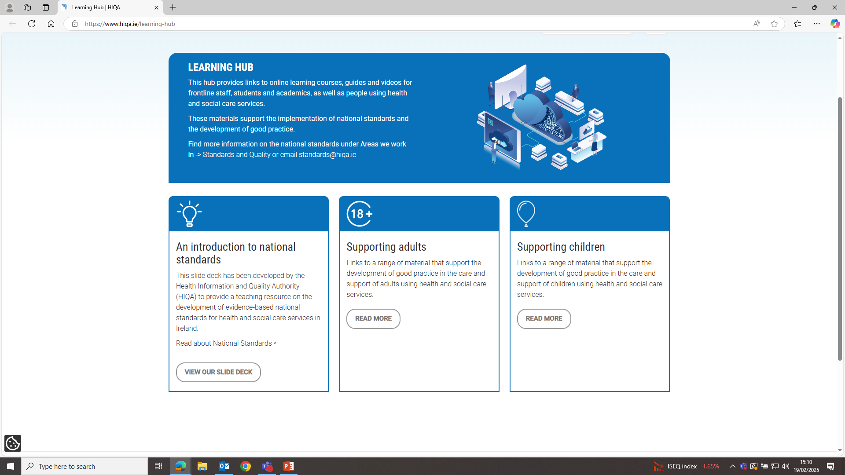
Where to find out more
You will find more information by visiting the Standards section on the HIQA website https://www.hiqa.ie. All resources are also available to view and download from the HIQA Learning Hub

Slide 141





Thank you
Contact us:
Email: standards@hiqa.ie
Follow us:
HIQA
@hiqa
@hiqaireland
@hiqaireland

